Slide 1
ISD PTSA COUNCIL PRESENTATION
January 27, 2022
Lorna Gilmour
Equity and Family Partnership Specialist
Issaquah School District

Slide 2
EL 16 – item #3
Promote an environment and culture that supports and encourages effective engagement of all families, including those from diverse backgrounds.
Mission and Goal of Family Partnership Team:
The Issaquah School District supports students’ success by supporting families.
To eliminate barriers and provide full access to all the educational opportunities in our district, we provide families supports such as Parent Workshops, access to Family Liaisons and resources to help staff better support our students and families.

Slide 3
Family Information Events
Family Education Events
Canvas and Family Access night (September)
Tips and Resources for Families new to the US public schools (August or October)
Communicating with Teachers at Parent Teacher Conferences (November)
8th grade Transition Night (January)
5th grade Transition Night (February)
Welcome to the ISD Kindergarten Families (March)
How to Report Incidents (HIB) at School (April 2021)
EVP support in August* (In person and Zoom help)
Each event in three to four sessions
English
Spanish
Chinese
Other (Korean or Japanese)
Translated PowerPoints in Spanish and Chinese
Currently on Zoom
In pervious years – included childcare to make events accessible

Slide 4
Family Partnership Team
Lorna Gilmour
Ina Ghangurde – Liaison
Liliana Medina – Liaison
Wenli Mithal – Liaison
Liaisons work in buildings supporting the schools and families at the schools.
Meet with parents.
Meet with students as needed.
Work and support staff as cultural brokers
Role is not school interpreters or translators.
District contracts with business for those services.

Slide 5
Translation and Interpretation Support
Training for all staff that interacts with families on how to support families with interpreters (certificated staff, office staff, Admin staff)
Work with departments on ensuring documents are accessible to ALL families. (format of document on website, eNEWS accessibility, etc)
Identify Preferred Language of family each year so that staff can contact families eliminating barriers for families and building stronger relationships with families.
Provide resources and tips on communication strategies (example – speaking and reading level)

Slide 6
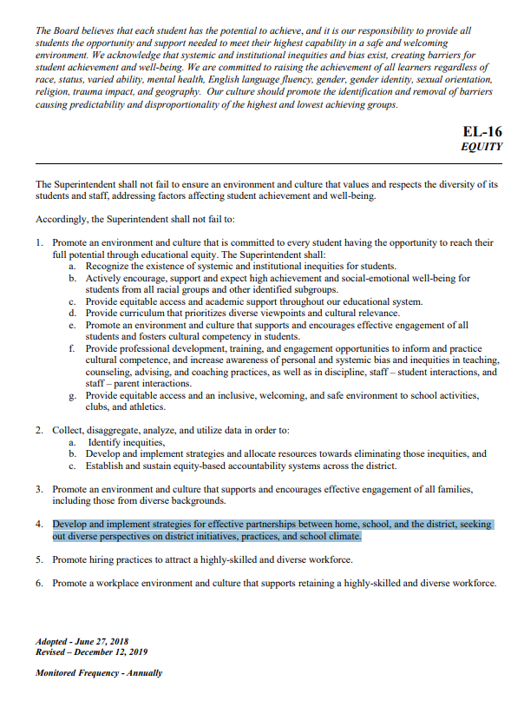
EL 16 – item #4
Develop and implement strategies for effective partnerships between home, school, and the district, seeking out diverse perspectives on district initiatives, practices, and school climate.

Slide 7
Diverse Perspectives and Voice
Family Partnership Advisory Group meetings to learn how we can better support families in our district. Feedback from parents of district initiatives. Report to director suggestions from group.( Group includes cultural, religious and linguistically diverse families)
Partnership with ISD FACE chairs at each school to support engagement activities at each school.
Family Connections meeting (3X year) to connect with new families, have families connect with each other.
Parent Panel PDs at schools as requested – provide diverse perspectives and parent voice.

Slide 8
EL 16 – item #1
Promote an environment and culture that supports and encourages effective engagement of all students and fosters cultural competency in students.
Provide professional development, training, and engagement opportunities to inform and practice cultural competence, and increase awareness of personal and systemic bias and inequities in teaching, counseling, advising, and coaching practices, as well as in discipline, staff – student interactions, and staff – parent interactions.

Slide 9
Cultural Competency PDs for staff
Dual Partnership – use information learned from families in PDs for staff.
Tips and strategies on communicating with families – diverse perspectives based on culture (values and beliefs)
Check assumptions and biases - Understanding school system understanding of families, cultural and religious beliefs
Includes Religious and Cultural Celebrations calendar for staff

Slide 10
Other EL 16
#2 – use data to support families – survey and feedback for families.
Academic data, FnRL, Preferred Language Data, Foreign born resident data for Census 2020
Support hiring of diverse staff – Classified Employment Recruitment night in October
Cultural Competency PDs support our diverse staff who comprise less than 10% of certificated staff. (School climate for teacher retention)

Slide 11
Thank you!
How can families connect with a liaison?
Call or email liaison. (website)
Liaisons also have Text number to communicate with families.
Liaisons contact all new families starting in September to welcome them to the school through an email, text or phone call.
School counselors, Admin, registrar and teachers connect families with the school liaison if the family needs support due to barriers in language, school system understanding, financial or other resource needs.

