Slide 1
Executive Limitations-16 (EL-16)
The School Board has adopted EL-16 to ensure an environment and culture that values and respects the diversity of it’s students and staff, addressing factors affecting student achievement and wellbeing.

Slide 2
Equity in Education
Definition
Raising the achievement of all students while narrowing the gap between the highest and lowest performing students and eliminating the racial predictability and disproportionality of which student groups occupy the highest and lowest achievement categories.
Notes:
Equity is not a strategy or a content.
https://forms.gle/Ch5Dg2euB5q7RyVSA

Slide 3
Environment and Culture
Building Professional Development
Building Equity Leads
Student Voices
Collaborating with Departments
Promoting an environment and culture that is committed to every student having the opportunity to reach their full potential through educational equity.
Notes:
Working with Student Interventions – PBSES, Interventions, Land Acknowledgments – PD Series, Identify and educate on months and days, Courageous conversations with staff and students, GLAD building leads, d

Slide 4
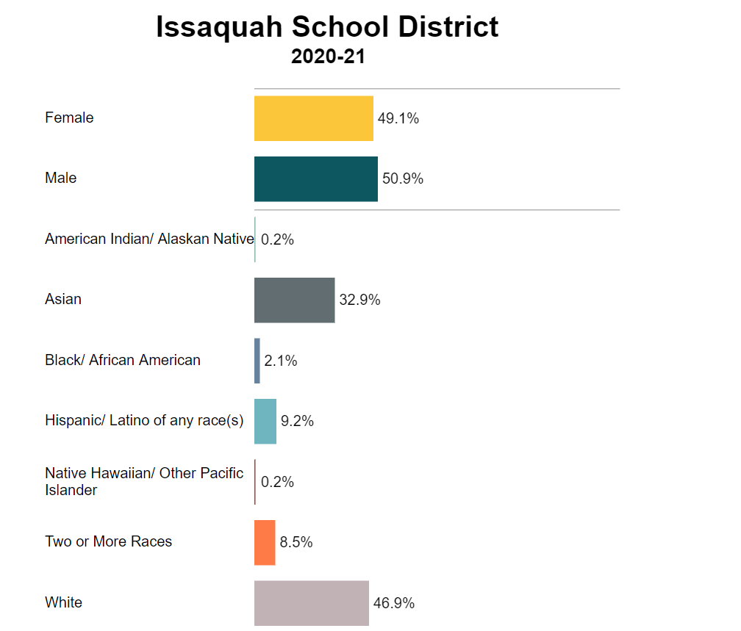
Data
Collect, disaggregate, analyze and utilize data
Notes:
White teachers vs teachers of color 87%. Discipline Data, Technology data, special education services, disproportionality committee.

Slide 5
Recruitment
Promote hiring practices to attract a highly-skilled and diverse workforce
Notes:
Alaina has worked with Human Resources to change and incorporate new questions in the interview process.

Slide 6
Retention
Promote a workplace environment and culture that supports retaining a highly-skilled and diverse workforce
Educators of Color Group
Checking in on Teachers
Building Lead Support
Courageous Conversation
Notes:
Calling in/calling out

Slide 7
Community Partnership
Community Equity Group
Meet with city programs
Connect with other districts
Family and Community Engagement
Notes:
Meet with Northshore, Bellevue and other schools in our Puget Sound

