Slide 1
WELCOME!
THANK YOU FOR BEING HERE!

Slide 2
MISSION
Issaquah Schools Foundation, in partnership with the Issaquah School District, drives resources to help all students achieve the promise of their potential.

Slide 3
VISION
We create limitless opportunities that inspire our students on their personal path to success.

Slide 4
FOUNDATION CORE VALUES
We put students’ needs first, focusing on the whole child.
We create opportunity.
We collaborate with our partners.
We seek innovation.
We focus on results.
We recognize and build relationships with our donors.

Slide 5
What is the Issaquah Schools Foundation?
A 34-year-old community powered nonprofit
The Foundation helps students
build an academic foundation
explore opportunities, and
launch students into their future.
The Foundation has channeled over $13 million into schools.

Slide 6
Who do we support?
Your students!
Over 18,500 students
26 schools (and growing)
110 square miles serving 5 cities: Issaquah, Sammamish, Bellevue, Newcastle, and Renton

Slide 7
Why do we need the Issaquah Schools Foundation?
State and local funding only covers basic education.
The pandemic has further burdened state & federal funding.
The economic impact upon families has increased basic student needs including food aid.
Students deserve the highest quality educational experience possible, the Foundation funds district-wide programs that are not directly supported by tax dollars.

Slide 8
Issaquah Schools Foundation Board
Board of Trustees
Chair, Trustees, Emeritus, Ex-Officio
Committees
Advisory Councils
Task Forces
Executive Director
Board Development Committee
Corporate Advisory Council
Strategic Planning
Staff
Executive Committee
Cultural Outreach Council
Insight/ Special Issue
Finance Committee
Diversity, Equity & Inclusion Task Force
Technology Advisory Council
Human Resources Committee
Program Committee
Program Grant Oversight
Ambassador Program
Resource Development Committee

Slide 9
2021-22 Board of Trustees
Executive Committee
Jenell Tamaela, President Cloe Zeng, Past President
Sara Miller, Past President
Shindy Baines, Secretary
Laila Collins, Treasurer
Erica Fewel, Member At Large & Board Governance
Committee Chairs
Sara Miller – Board Recruitment
Mike Kernish – Student Trustees Trisha Marshal – Programs Oversight
Swati Jain – Human Resources, Board Development
Ian Terry & Monica Abel – Finance
Resource Development, Technology Chairs Open

Slide 10
Issaquah Schools Foundation Staffing
Alicia Spinner, PT
Cultural Bridges Prog. Mgr.
Laura Ni
Contractor
Cultural Bridges - Editor
Carolyn Kennedy PT Director of Programs
Nikki Singh PT
Programs Coordinator
Cornell Atwater FT
Executive Director
Michelle Hammer PT Marketing & Communications
Katie Milne FT
Business Manager
Valerie Korock PT
Business * Corp Development Manager
Development Team
Allyson Ross
Major Gifts/Development Officer
Natalie Undi PT Database & Donor Records
Volunteers
Data Entry
Thank you Notes
Admin
Revised 10.24.21

Slide 11
How do we fuel success for students? By investing in a variety of areas that support them.

Slide 12
COVID Response Special Projects
Ask an Expert: provided tech support for Microsoft programs, applications, and other computer/tech trouble shooting issues to ISD staff, teachers, and families​
Food Aid: partnered with the Issaquah Food & Clothing Bank to deliver Lunch for the Break, additional 500 grocery gift cards (like cash!) during spring and summer vacations, and weekly drive-by pick up.​
​Cultural Bridges: More than 300 families received direct support in eight languages to help them navigate the school system​. 4 Summer Reading sessions. Translation services support in 7 languages.
ParentWiser: sponsor of this Issaquah PTSA Council program which offered 2 parenting webinars in April, a college exploratory webinar in June, and a robust lineup of speakers throughout 2020-21all in new online webinar formats!
Basic Needs: Families that need financial support received more than 1000 free backpacks filled with school supplies to help kids go back to school with confidence​.
Mental & Emotional Support: Racial Trauma Training for ISD, Forefront Suicide Prevention Training for ISD, Swedish mental health counselor funding support, Healthy Youth Initiative Survey, Action Forum for Youth with Influence the Choice
Equity & Opportunity Fund – headphones, small desks, laptop repair/replacement & insurance
Academic Support – $65,000 in Student Academic Grants for 130 students @ $500

Slide 13
What funding do we provide?
After school academic support (allocation for all schools)
Dedicated fine arts fund (band, orchestra, choir, theater, and visual arts)
Food aid in schools
Tools4Schools: free backpacks & school supplies for students in need
Grants for teachers
Math, Reading and Science Curriculum
Mental & Behavioral health support
Parent education opportunities (Parenting ToolBox, ParentWiser)
Professional Development for teachers
Robotics, coding, and STEM clubs

Slide 15
Cultural Bridges Information, Resources & Community Outreach
Digital & Print Magazines, Family Guide, Formation of a Cultural Diversity Outreach Task Force

Slide 17
TEACHER GRANTS Apply: November 2021 Classroom Enrichment Kateri Brow
CAROLYN KENNEDY – c.kennedy@isfdn.org

Slide 18
STUDENT ACADEMIC SUPPORT GRANTS Apply: DECEMBER 2021
CAROLYN KENNEDY – c.kennedy@isfdn.org

Slide 19
How do we raise money?
Enroll Verification Process (EVP)
Fall Campaigns – Step Up for Kids (Sept), Monster Mash 5k (Oct)
Nourish Every Mind – 24th Annual Fundraising event (April/May)
Individual & Major Gifts
Employee Giving Campaigns
Corporate Matching
Grants (City, State, For Profit/Non-Profit Organizations)
Business/Corporate Sponsorships & Support

Slide 20
WE RELY ON PARENTS, INDIVIDUAL & MAJOR DONORS FOR OVER 80% OF ANNUAL REVENUE….
However, only 1 of 8 district families donate.
The Foundation strives to make an impact upon all district students.
We need support from all district parents.

Slide 21
How can you help?
Share the impact of how Foundation programs have helped you and your students with your parents
Share our email news with your school community!
Provide ISF presentations at your parent meeting!
Subscribe to email newsletter, FB, Instagram
80% of our donations come from our individual/parent community.
With your help, we support every student in our district.

Slide 22
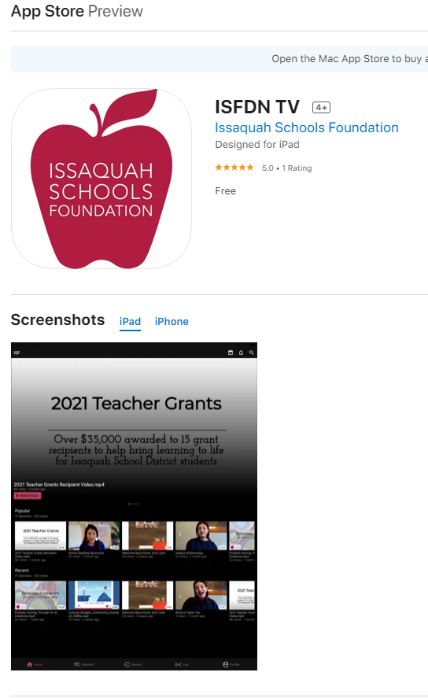
https://cloud.castus.tv/vod/#/isf/?page=HOME

Slide 23
HAVE A GREAT SCHOOL YEAR! THANK YOU FOR YOUR PARTNERSHIP!

