Slide 1
December 2017

Slide 2
President’s Report Becky Gordon & Leslie Kahler
Dear Issaquah PTSA Council Members,
This presentation was created to provide you information for the month of December even though we will not hold a membership meeting.
We hope this presentation is helpful for those who will hold a membership meeting this month.
Have a safe and happy holiday season!
See you in 2018!
Becky & Leslie

Slide 3
Open Council Positions
Membership
Advocacy
Co-Reflections

Slide 4
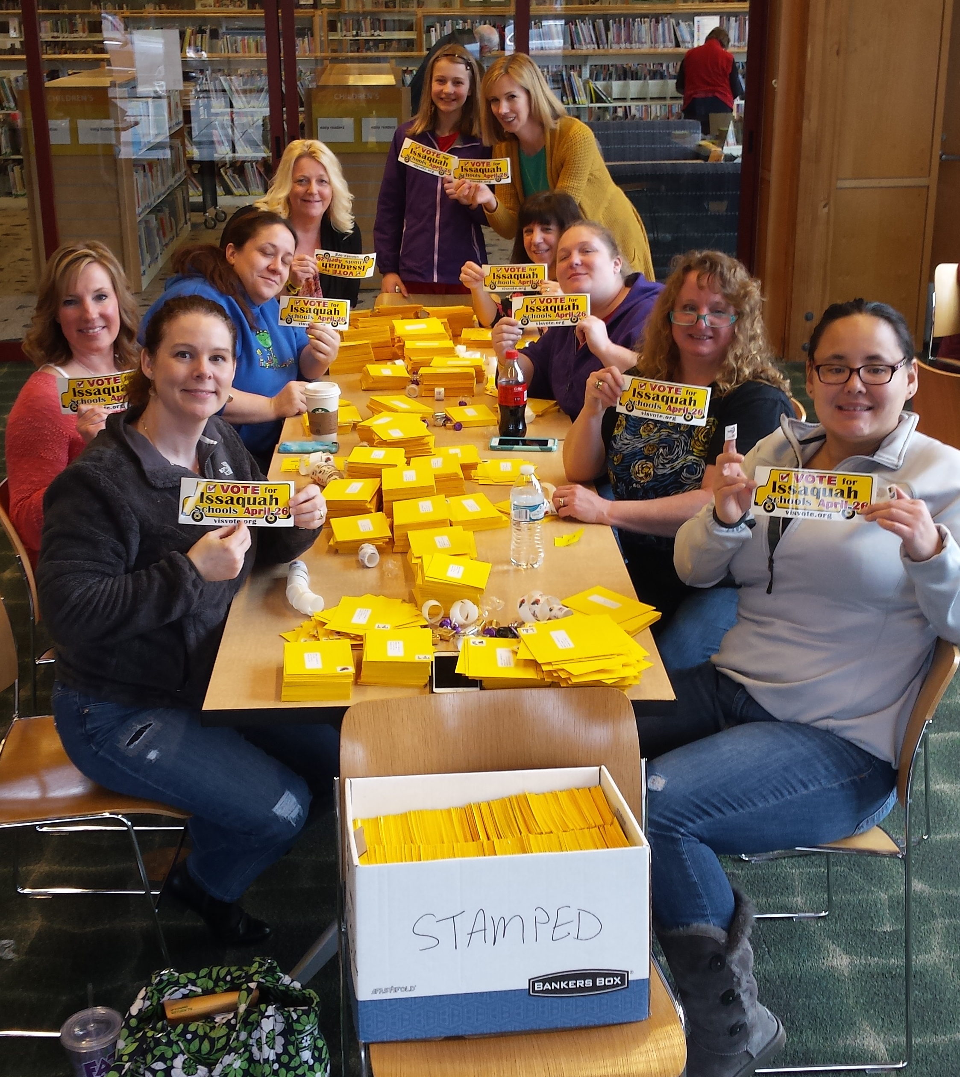
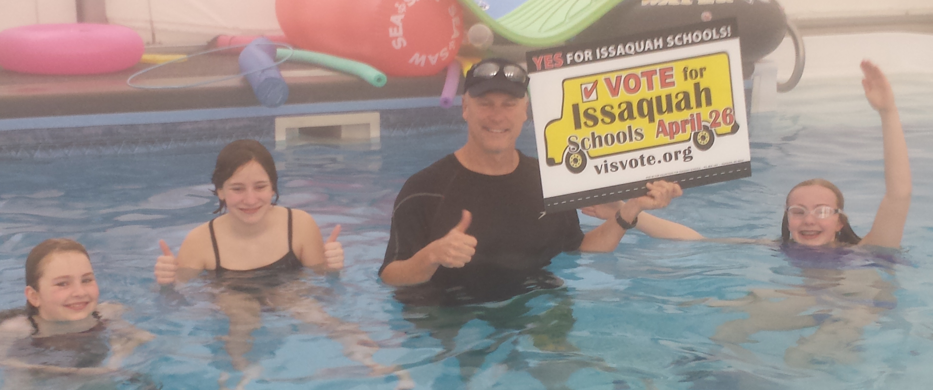
Volunteers for Issaquah Schools (VIS)
There is much info to send out!
We will send out an update next week when we have all the information collected and complied.
Stay tuned!
If you would like more information please visit www.visvote.org
and please LIKE! Volunteers for Issaquah Schools on Facebook

Slide 5
Best Practices Open
Nominating Committee training
Monday, January 22
10 am -12:30pm
Issaquah Library Meeting Room
It is recommended that all PTAs/PTSAs complete a Financial Mid year review in January
Now is a good time to appoint your committee if you haven’t already done so

Slide 6
Membership Open
Report
Congratulation to everyone – All PTAs/PTSAs have earned the Bronze membership award
Silver – Skyline HS
Gold – Briarwood and Creekside
Platinum – Discovery
Time for your Winter Campaign (Nov-Dec)
Platinum Membership
20% increase from the past year’s membership
You do not apply for this award

Slide 7
Advocacy Open
Input Needed by December 4 on Focus Day Survey
In past years, WSPTA has organized a one-day advocacy event in Olympia, in January or February, for a day of issue education and of talking to legislators about our priorities.
But we know that Focus Day does not fit the needs of EVERY advocate; WSPTA is a statewide association, and not all our members who want to advocate for our platform CAN make it to Olympia.
Our advocacy also cannot and should not be limited to a single day. For the 2018 legislative session, our goal is to engage as many members in our advocacy as possible, and we value your thoughts.
Please take this survey by December 4, and share it with your council, local PTA leaders, and members. We want to hear as many voices as possible!
This survey will only take a few minutes of your time!

Slide 8
Standing Committees
Art in the Schools - Artist support
Family and Community Engagement (FACE)
Healthy Youth Initiative
Issaquah Schools Foundation
Outreach
Parentwiser
Reflections
Special Education
Webmaster

Slide 9
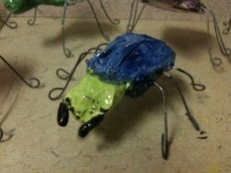
SMALL PROJECTS – REUSED CLAY DEC 15TH 12 – 2:30 Art East Kiln Annex
http://www.signupgenius.com/go/10c0a49aea72ba13-small
Small Projects - Reused clay
Juliette Ripley-Dunkelberger, a local ceramic artist, will be teaching the basics of working with clay. She will demonstrate hand building that can be used with scrap clay and elementary school kids. You will create a project as an example for use at your school. You will take home your example for firing at your school as well as two lesson plans to share with your school.
This event will be held at the Art East Kiln Annex. Please meet at Art East at noon and we will walk over to the kiln annex together. Please park around Art East as you usually would as there is very little parking around the annex. If you are coming in late you can ask for assistance at Art East or walk over on your own. The building we are in is on the back of the property, shared with the salon.
Art East Kiln Annex 195 First Place NW #400

Slide 10
FACE @issaquahptsa.org Ina Ghangurde
Identify a FACE liaison at every school
Preferably, this person should be multi-cultural
Contact me with questions or for help if needed
Hand outs!

Slide 11
ISSAQUAH SCHOOLS FOUNDATION
LIAISON: Valerie Yanni
Holiday Shopping for a Cause
Shop with retailers that donate a percentage of your sale to the Foundation!
Visit the Shop for a Cause page for links and more information
Businesses include Barnes & Noble, Amazon, Fred Meyer Rewards, and Hop Jacks
VOICE Book Drive at Barnes & Noble Issaquah
From November 27th to December 4th, Barnes & Noble Issaquah is donating 15% of all purchases to the Foundation’s VOICE Mentor program when you bring in the flyer or use the online code. LINK HERE
December 6 | Dining for Kids – Chinoise Sushi Bar & Asian Grill
Dec 6-10 | Jersey Mike’s Grand Opening – Free Sub with $2 donation to the Foundation, Coupon required. (SEE FLYER NEXT SLIDE)
December 14 | Great Careers Conference – Bellevue College – find out more about great careers that can be achieved with certification or a two-year degree. HIGH SCHOOL STUDENTS REGISTER HERE
January 3 | Dining for Kids at Zeek’s Pizza
May 10 | Annual Nourish Every Mind Luncheon at Meydenbauer Center, Bellevue
May 22 | Annual Nourish Every Mind Breakfast at Eastridge Church, Issaquah

Slide 12
JERSEY MIKE’S SUBS GRAND OPENING
benefitting
THE ISSAQUAH SCHOOLS FOUNDATION
$2 Donation to the Foundation at restaurant
gets you a Jersey Mike’s sub of your choice
Wednesday, December 6 – Sunday, December 10th
Coupon Required
Pick yours up at the Foundation Office or
Jersey Mike’s Store!
(Next door to Café Rio)
OR If you want a stack of coupons to hand out at your school, email isf-rep@issaquahptsa.org

Slide 13
Outreach Chair: Kim Weiss outreach@issaquahptsa.org
IFCB Holiday Gift Barn www.issaquahfoodbank.org/holiday-gift-barn
Donor Drop Off: Monday & Tuesday, Dec 4th and 5th
Family Pick Up: Wednesday & Thursday, Dec 6th and 7th
Volunteers Needed !
Register your gift to help with planning
Lunch For The Break www.lunchforthebreak.com
100 boxes still needed!
Donor Drop Off: Monday, Dec 18 2pm – 7pm
Register your donation to assist with planning
Family Pick Up: Tuesday, Dec 19 2pm – 7pm

Slide 15
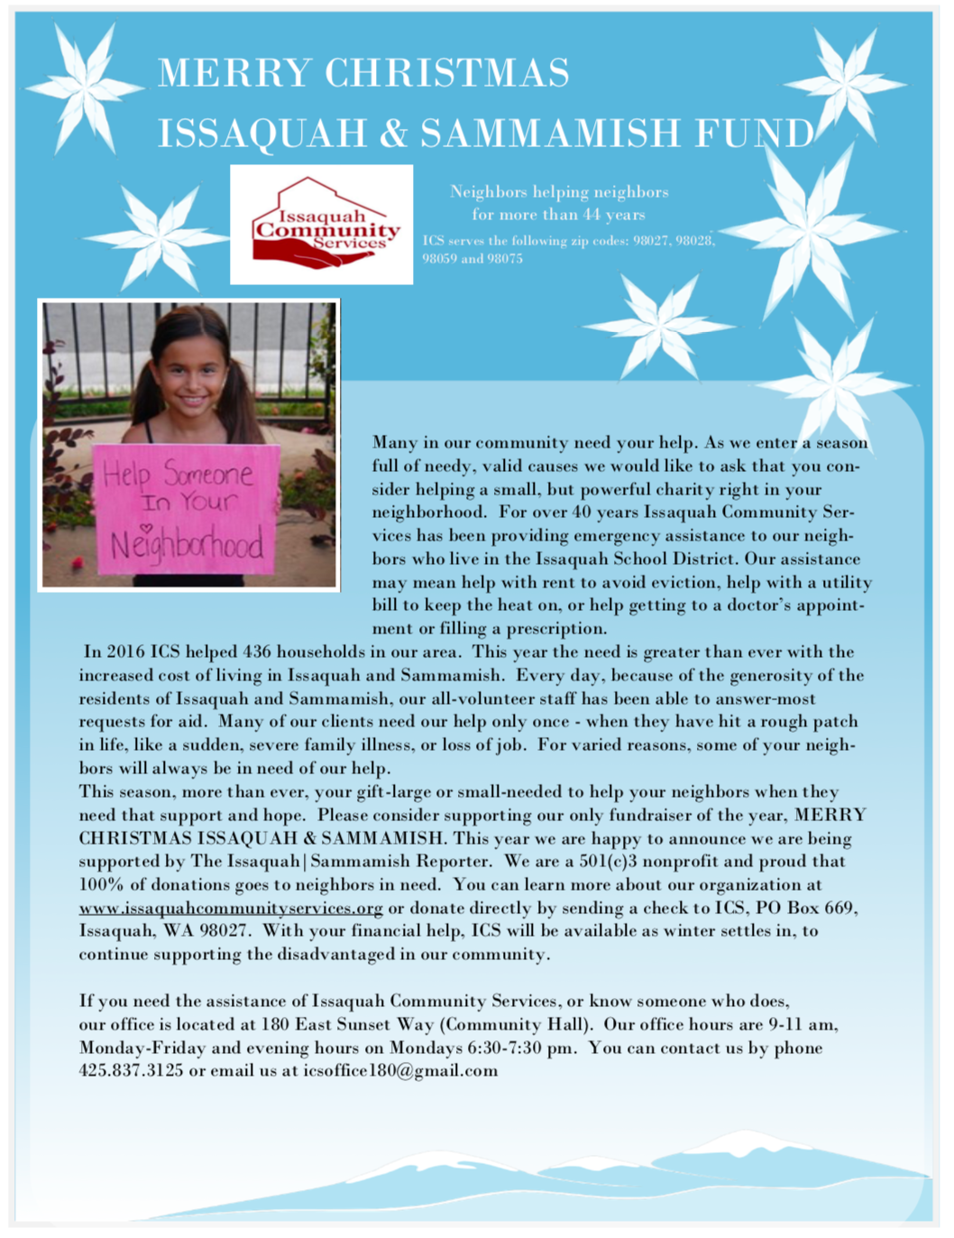

Slide 16
ParentWiser Heidi Fuhs & Debbie Steinberg Kuntz
NEW! Exclusive ParentWiser LIVE interview with NY bestselling author Tina Payne Bryson on Dec 13 at 1pm at: https://zoom.us/j/844233598
New book Yes Brain coming in Jan 2018 !
Also co-authored with Dr Dan Siegel, books No Drama Discipline and the Whole Brain Child
iRules Workshop online! If you missed it, click on the video at http://parentwiser.org/watch-online
Angst Film Documentary Jan 24th at 7pm at IHS.
Additional screening at Liberty HS date/time coming soon! All registrations will be posted at http://parentwiser.org/events
Parent Ed Reps, Communications and Facebook Admins have been notified!
Feel free to follow-up with any above information to your local school community.

Slide 17
Reflections Leah Gibson
District Reflections Reception
Tuesday, January 9, 2018
6:30-8:00 pm at IHS
Volunteers needed!
Set-up/take-down
Contact: leahgibson.gsww@gmail.com

Slide 22
Upcoming Events
Participating in an IEP Meeting
December 4, 6:30-8pm
Issaquah Middle School Library
District wide Reflections Reception
January 9, 6:30 – 8:30 pm
Issaquah High School Commons
VIS Community Night
January 11 at 7pm
Swedish Hospital – Issaquah Highlands
Nominating Committee training
January 22, 10am - 12:30pm
Issaquah Library Meeting Room

Slide 23
Questions?
Elementary Schools
South: Korista Smith-Barney vp-el-south@ issaquahptsa.org
Apollo, Briarwood, Maple Hills, Newcastle
Central: Wendy Shah vp-el-central@ issaquahptsa.org
Clark, Cougar Ridge, Grand Ridge, IVE, Sunset
North: Ina Ghangurde vp-el-north@ issaquahptsa.org
Cascade Ridge, Challenger, Creekside, Discovery, Endeavour, Sunny Hills
Middle Schools: Laila Collins vp-middle@issaquahptsa.org
High Schools: Ina Ghangurde vp-high@issaquahptsa.org

Slide 24
Additional Contacts
Issaquah PTSA Council
Council Presidents President@Issaquahptsa.org
Becky Gordon & Leslie Kahler
Treasurer: Erin Eaton Treasurer@issaquahptsa.org
Membership: Open Membership@issaquahptsa.org
Washington State PTA
Region 2 Director: Mindi Lincicome PTAreg2@WAstatePTA.org
Area B Director: Jane Dulski AreaBvp@WAstatePTA.org
President: Michelle Nims PTApres@WAstatePTA.org
Executive Director: Kathryn Hobbs khobbs@WAstatePTA.org
Staff: Amanda Starr-Smith Support@WAstatePTA.org Tatia Vasbinder

Slide 25
The Issaquah PTSA Council is Here to Support You in Everything You Do
Thank You for Your Service to the Families and Students in the Issaquah School District!

