Slide 1
November 9, 2017

Slide 2
President’s Report Becky Gordon & Leslie Kahler
Thank you!
Liberty High PTSA – For hosting One Love for the district
Parentwiser – iRules
New password to the Leadership Guides
Username: Every Password: Child
PTA and the Principal – November 16
11:45 – 12:45 L. Michelle & Moriah Banasick (all presidents)
12:45 – 1:15 Elem. Presidents join the Elem principal’s meeting – already in progress
Executive Limitation – 16 Equity
Mailchimp calendar of events – discontinue
December training?
Echo Glen support

Slide 3
Echo Glen Support
Here’s what volunteers are currently doing:
http://www.smilepower.org/Echo_Glen_Children_s_Ctr.html
Giving Trees – the wonderful staff at Echo Glen has so many ideas on how to help the youth rewrite the scripts of their lives. Know any group that would consider ‘adopting’ some items on a wish list? Any gifts would actually benefit many many youth and over many years rather than going to just one youth.
https://smile.amazon.com/gp/registry/wishlist/V0FZYMV60E87/ref=nav_wishlist_lists_1
Facebook:
https://www.facebook.com/SupportingIncarceratedYouth/

Slide 4
Open Council Positions
Membership
Advocacy
Co-Reflections

Slide 5
Consent Agenda I move we accept the consent agenda as presented (items can be removed for discussion or amended)
October 12, 2017 Membership Meeting Minutes
October 2017 Treasurer’s Report
No claims were filed on our insurance policy during this period
All documents are posted on the Meeting Documents page

Slide 6
Secretary @issaquahptsa.org Erin Thacker
No report

Slide 7
Treasurer @issaquahptsa.org Erin Eaton
Council Dues Due: October 31
Taxes Due: November 15
Insurance Due: December 1
Financial Review Committee: Korista Smith-Barney, Wendy Shah, and Laila Collins

Slide 8
Council Business
Nominating Committee Election
Laila Collins
Wendy Shah
?

Slide 9
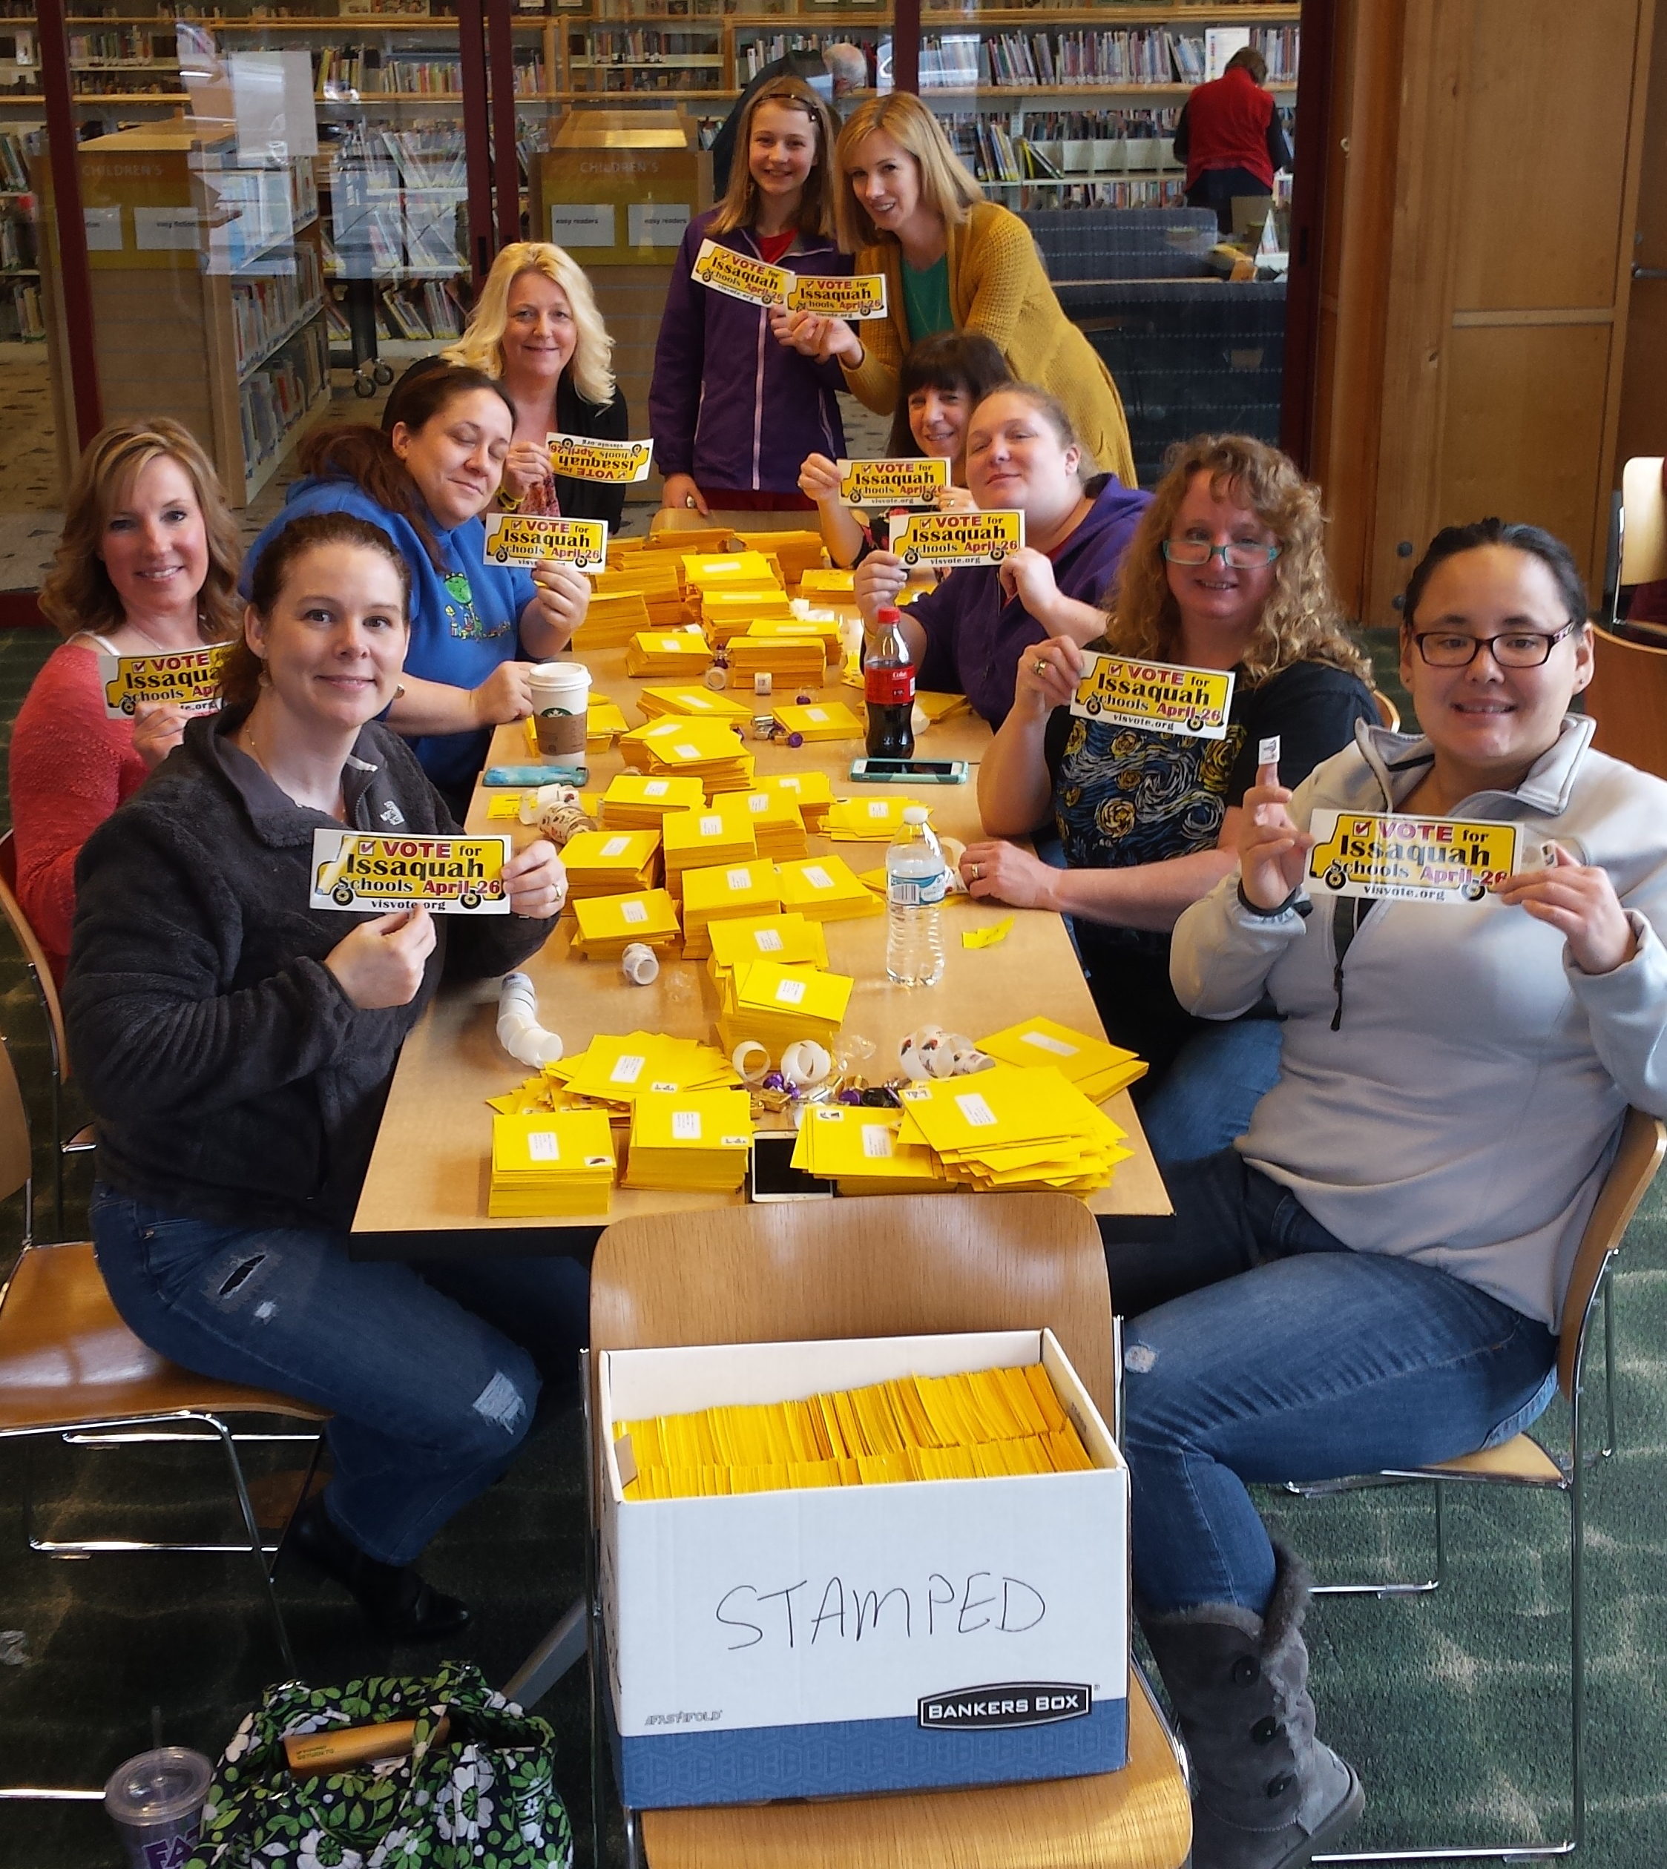
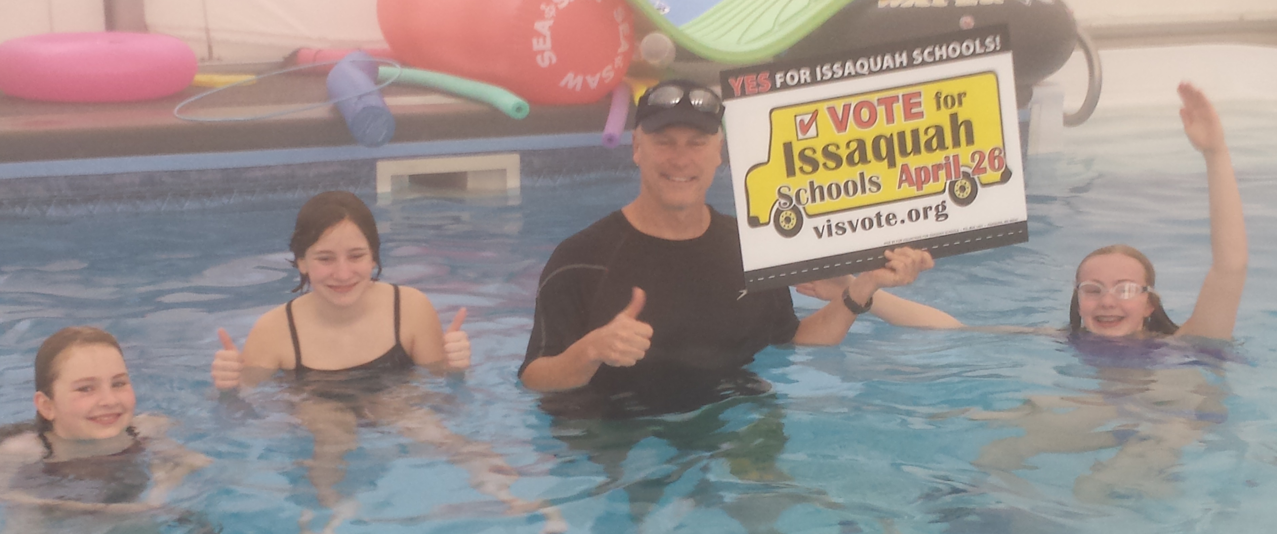
Volunteers for Issaquah Schools (VIS)
Volunteers for Issaquah Schools is a non-profit 501(c)4 organization that works to promote passage of Issaquah School District bond and levies. VIS provides information about these ballot measures to our PTA membership so our members can make an informed decision to promote a YES VOTE! for our Schools.
What is a Volunteers for Issaquah Schools (VIS) PTSA Representative?
• A VIS Rep can be 1-2 people willing to facilitate sharing information to their organization/group (ex: PTA, Homeowners Assoc., NextDoor group, or any other organized club/group/business) and help organize volunteers with various activities that support the passing of school bonds/levies. This role can be as simple or as involved as one would like!
• The VIS Board Members and Steering Committee do the main tasks during the campaign, and then reach out to local VIS Reps with info to share or requests for help. You are never left on your own and have our full support as a team! The committee works to make tasks easy for our volunteers.
Tasks may include:
• Hosting/organizing a speaker presentation to your group
• Sharing information with your organization for distribution
• Sharing information via social media, newsletters, etc.
• Encourage voters to pass school bonds/levies and to endorse them
• Organizing volunteers for sign Honk & Waves near voting dates
• Organizing volunteers for distributing literature door-to-door (for bonds)
• Possible help with postcard/letter mailings
At minimum, a VIS Rep would help with the first four tasks, and let the committee know if they need help with or are unable to participate in the remaining. If you are interested in a larger role please reach out to Dawn Peschek, at dawn@visvote.org or Alicia alicia@visvote.org.
THANK YOU SO MUCH!
If you would like more information please visit www.visvote.org
and please LIKE! Volunteers for Issaquah Schools on Facebook

Slide 10
Notecard Questions???
At this time questions submitted will be discussed

Slide 11
Best Practices Open
Korista Smith-Barney
Nominating Committee – find nominees/elect
Recognize your Reflections participants
Start Promoting the “Men’s Making a Difference” student essay contest

Slide 12
Membership Open
Report
Time for your Winter Campaign (Nov-Dec)
Gold Membership
10% increase from the past year’s membership
You do not apply for this award

Slide 13
Advocacy Open
Delegates adopted resolutions on:
Mental Health Needs for Children
Trauma Informed Care
Increasing Access and Affordability of Post-secondary/Higher Education Degrees and Certificates
LGBTQ+ Inclusion
The following legislative issues were added to the “Also Supported” list for the 2018 Legislative Platform (in alphabetical order):
Addressing the Teacher Shortage
Best Practices for School Meal Policies
Career Connected Learning, CTE & Stem
Dual Credit Equality & Support
Equity for Highly Capable
Preventing and Mitigating the Impacts of Gender-based Violence
School Construction and Class Size Reduction
Read the full recap of the 2017 WSPTA Legislative Assembly at https://www.wastatepta.org/2017-wspta-legislative-assembly-recap/

Slide 14
Standing Committees
Art in the Schools - Artist support
Family and Community Engagement (FACE)
Healthy Youth Initiative
Issaquah Schools Foundation
Outreach
Parentwiser
Reflections
Special Education
Volunteers for Issaquah Schools (VIS)
Webmaster

Slide 15
Outreach Guest Speaker: Rebecca Rice Chair: Kim Weiss outreach@issaquahptsa.org
Upcoming Events:
Turkey Trot www.issaquahturkeytrot.org
9am, Thanksgiving morning. New route !
Volunteers Needed !
Register online
IFCB Holiday Gift Barn www.issaquahfoodbank.org/holiday-gift-barn
Donor Drop Off: Monday & Tuesday, Dec 4th and 5th
Family Pick Up: Wednesday & Thursday, Dec 6th and 7th
Volunteers Needed !
Register your gift to help with planning
Lunch For The Break www.lunchforthebreak.com
Goal of 450 boxes for December break
Donor Drop Off: Monday, Dec 18 2pm – 7pm
Register your donation to assist with planning
Family Pick Up: Tuesday, Dec 19 2pm – 7pm

Slide 16
Reflections Leah Gibson
Turn-in date - Monday, November 20th from 10-12 at the Issaquah Library
Number of Finalists to District-12 entries as a base amount regardless of participation, 15 entries with 75+, 18 entries with 100+.
District Reflections Reception –Tuesday, January 9, 2018 from 6:30-8:00 pm at IHS. Set-up/take-down help needed!

Slide 17
Co-Chairs: Heidi Fuhs Debbie Steinberg Kuntz
Pick up TABLE TENTS to place in your school lobby.
ParentWiser and your PTA/PTSA:
Add ParentWiser events as a benefit of PTSA Membership!
Mention upcoming ParentWiser events at your General Membership Meetings. (Pass around flyer for upcoming event, or list of speaker series.)
Host a local parent ed speaker for your General Membership? Ask/inform ParentWiser for recommendations.
Communications:
for SCHOOL AND PTSA ENEWS - copy/paste to avoid errors & omissions.
Add ParentWiser link/(logo above) to your MySchoolPages/PTSA website.
Link your PTSA Facebook/Website to ParentWiser Facebook.
Back-to-School Check In - if you collected parent names/emails for ParentWiser subscription, forward contacts list to parentwiser@issaquahptsa.org.

Slide 18
FACE @issaquahptsa.org Ina Ghangurde
Identify a FACE liaison at every school
Preferably, this person should be multi-cultural
Contact me with questions or for help if needed
Hand outs!

Slide 19
Issaquah Schools Foundation Liaison Valerie Yanni
Kateri Brow and Classroom Enrichment Grants
Grant applications are only accepted on line.
Visit isfdn.org/grants for dates and evaluations.
Access the online application.
View the judging rubric and the Grant Writing Workshop Presentation.
Over 300 Voice Mentors
If you would like to be a VOICE mentor email: voice@isfdn.org or call: 425-391-8557
DINING FOR KIDS Wednesday, Dec. 6th Chinoise Sushi Bar and Asian Grill (in the Issaquah Highlands next to the movie theater) Lunch and Dinner.

Slide 20
Special Education Carrie Hipsher
Identify special ed liaison at every school.
Preferably, this person should have a student with an IEP or 504.
Please send me Chair/Rep names. Special-ed@issaquahptsa.org or carriehipsher@Hotmail.com
Contact me with questions or for help if needed. I can probably help identify people at the schools.
Share “Club Inclusive” Facebook post to your school community.
Encourage your community to join our private Facebook group – www.facebook.com/groups/IssaquahSTAR

Slide 22
Healthy Youth Andie Adee
The Power of Me, The Power of We! Youth Summit
Saturday, November 11 from 9AM – 4PM
Pacific Cascade Middle School
High School students will receive volunteer hours to help facilitate break-out sessions and mentor middle school students
Registration at www.eventbrite.com/o/influence-the-choice-15321775883
This is an inspirational one-day FREE event for middle school students. We will enjoy food, fun, and friends as we learn about becoming change makers in the areas of substance abuse prevention and mental health promotion.

Slide 23
GLASS FUSING NOV. 17TH 12 – 2:30 Hailstone Feed Store
http://www.signupgenius.com/go/10c0a49aea72ba13-glass4
Come and learn the basics of purchasing, planing, safety, cutting and fusing glass projects for your students. Juliette will teach several projects and you will leave with an example (to be fired at your school) of a project which works with the age group you work with. 2nd - 5th grades
Class will be held at the Hailstone Feed Store
Hailstone Feed Store 232 Front Street North Issaquah, WA 98027

Slide 24
District Updates
Ron Thiele – ISD Superintendent
Doug Jones – President, Issaquah Education Association

Slide 25
Upcoming Events
PTA and the Principal: Elementary - November 16
11:45 – 12:45 Moriah Banasick and L. Michelle
All presidents should attend
12:45-1:15 Elementary Presidents join Principal's sectional
Reflections Turn-in - November 20
10 am – 12 pm
Issaquah Library
District wide Reflections Reception - January 9
6:30 – 8:30 pm
At IHS

Slide 26
New Business
Adjourn
Optional Q & A session

Slide 27
Questions?
Elementary Schools
South: Korista Smith-Barney vp-el-south@ issaquahptsa.org
Apollo, Briarwood, Maple Hills, Newcastle
Central: Wendy Shah vp-el-central@ issaquahptsa.org
Clark, Cougar Ridge, Grand Ridge, IVE, Sunset
North: Ina Ghangurde vp-el-north@ issaquahptsa.org
Cascade Ridge, Challenger, Creekside, Discovery, Endeavour, Sunny Hills
Middle Schools: Laila Collins vp-middle@issaquahptsa.org
High Schools: Ina Ghangurde vp-high@issaquahptsa.org

Slide 28
Additional Contacts
Issaquah PTSA Council
Council Presidents President@Issaquahptsa.org
Becky Gordon & Leslie Kahler
Treasurer: Erin Eaton Treasurer@issaquahptsa.org
Membership: Open Membership@issaquahptsa.org
Washington State PTA
Region 2 Director: Mindi Lincicome PTAreg2@WAstatePTA.org
Area B Director: Jane Dulski AreaBvp@WAstatePTA.org
President: Michelle Nims PTApres@WAstatePTA.org
Executive Director: Kathryn Hobbs khobbs@WAstatePTA.org
Staff: Amanda Starr-Smith Support@WAstatePTA.org Tatia Vasbinder

Slide 29
The Issaquah PTSA Council is Here to Support You in Everything You Do
Thank You for Your Service to the Families and Students in the Issaquah School District!

Slide 30
Lunch Anyone?
location

