Slide 1
ISD PTSA Reflections
Training & Information Resource for School Chairs
Presented by ISD PTSA Reflections Co-chairs:
Kristen Allen-Bentsen
Heather Bratton
Leah Gibson

Slide 2
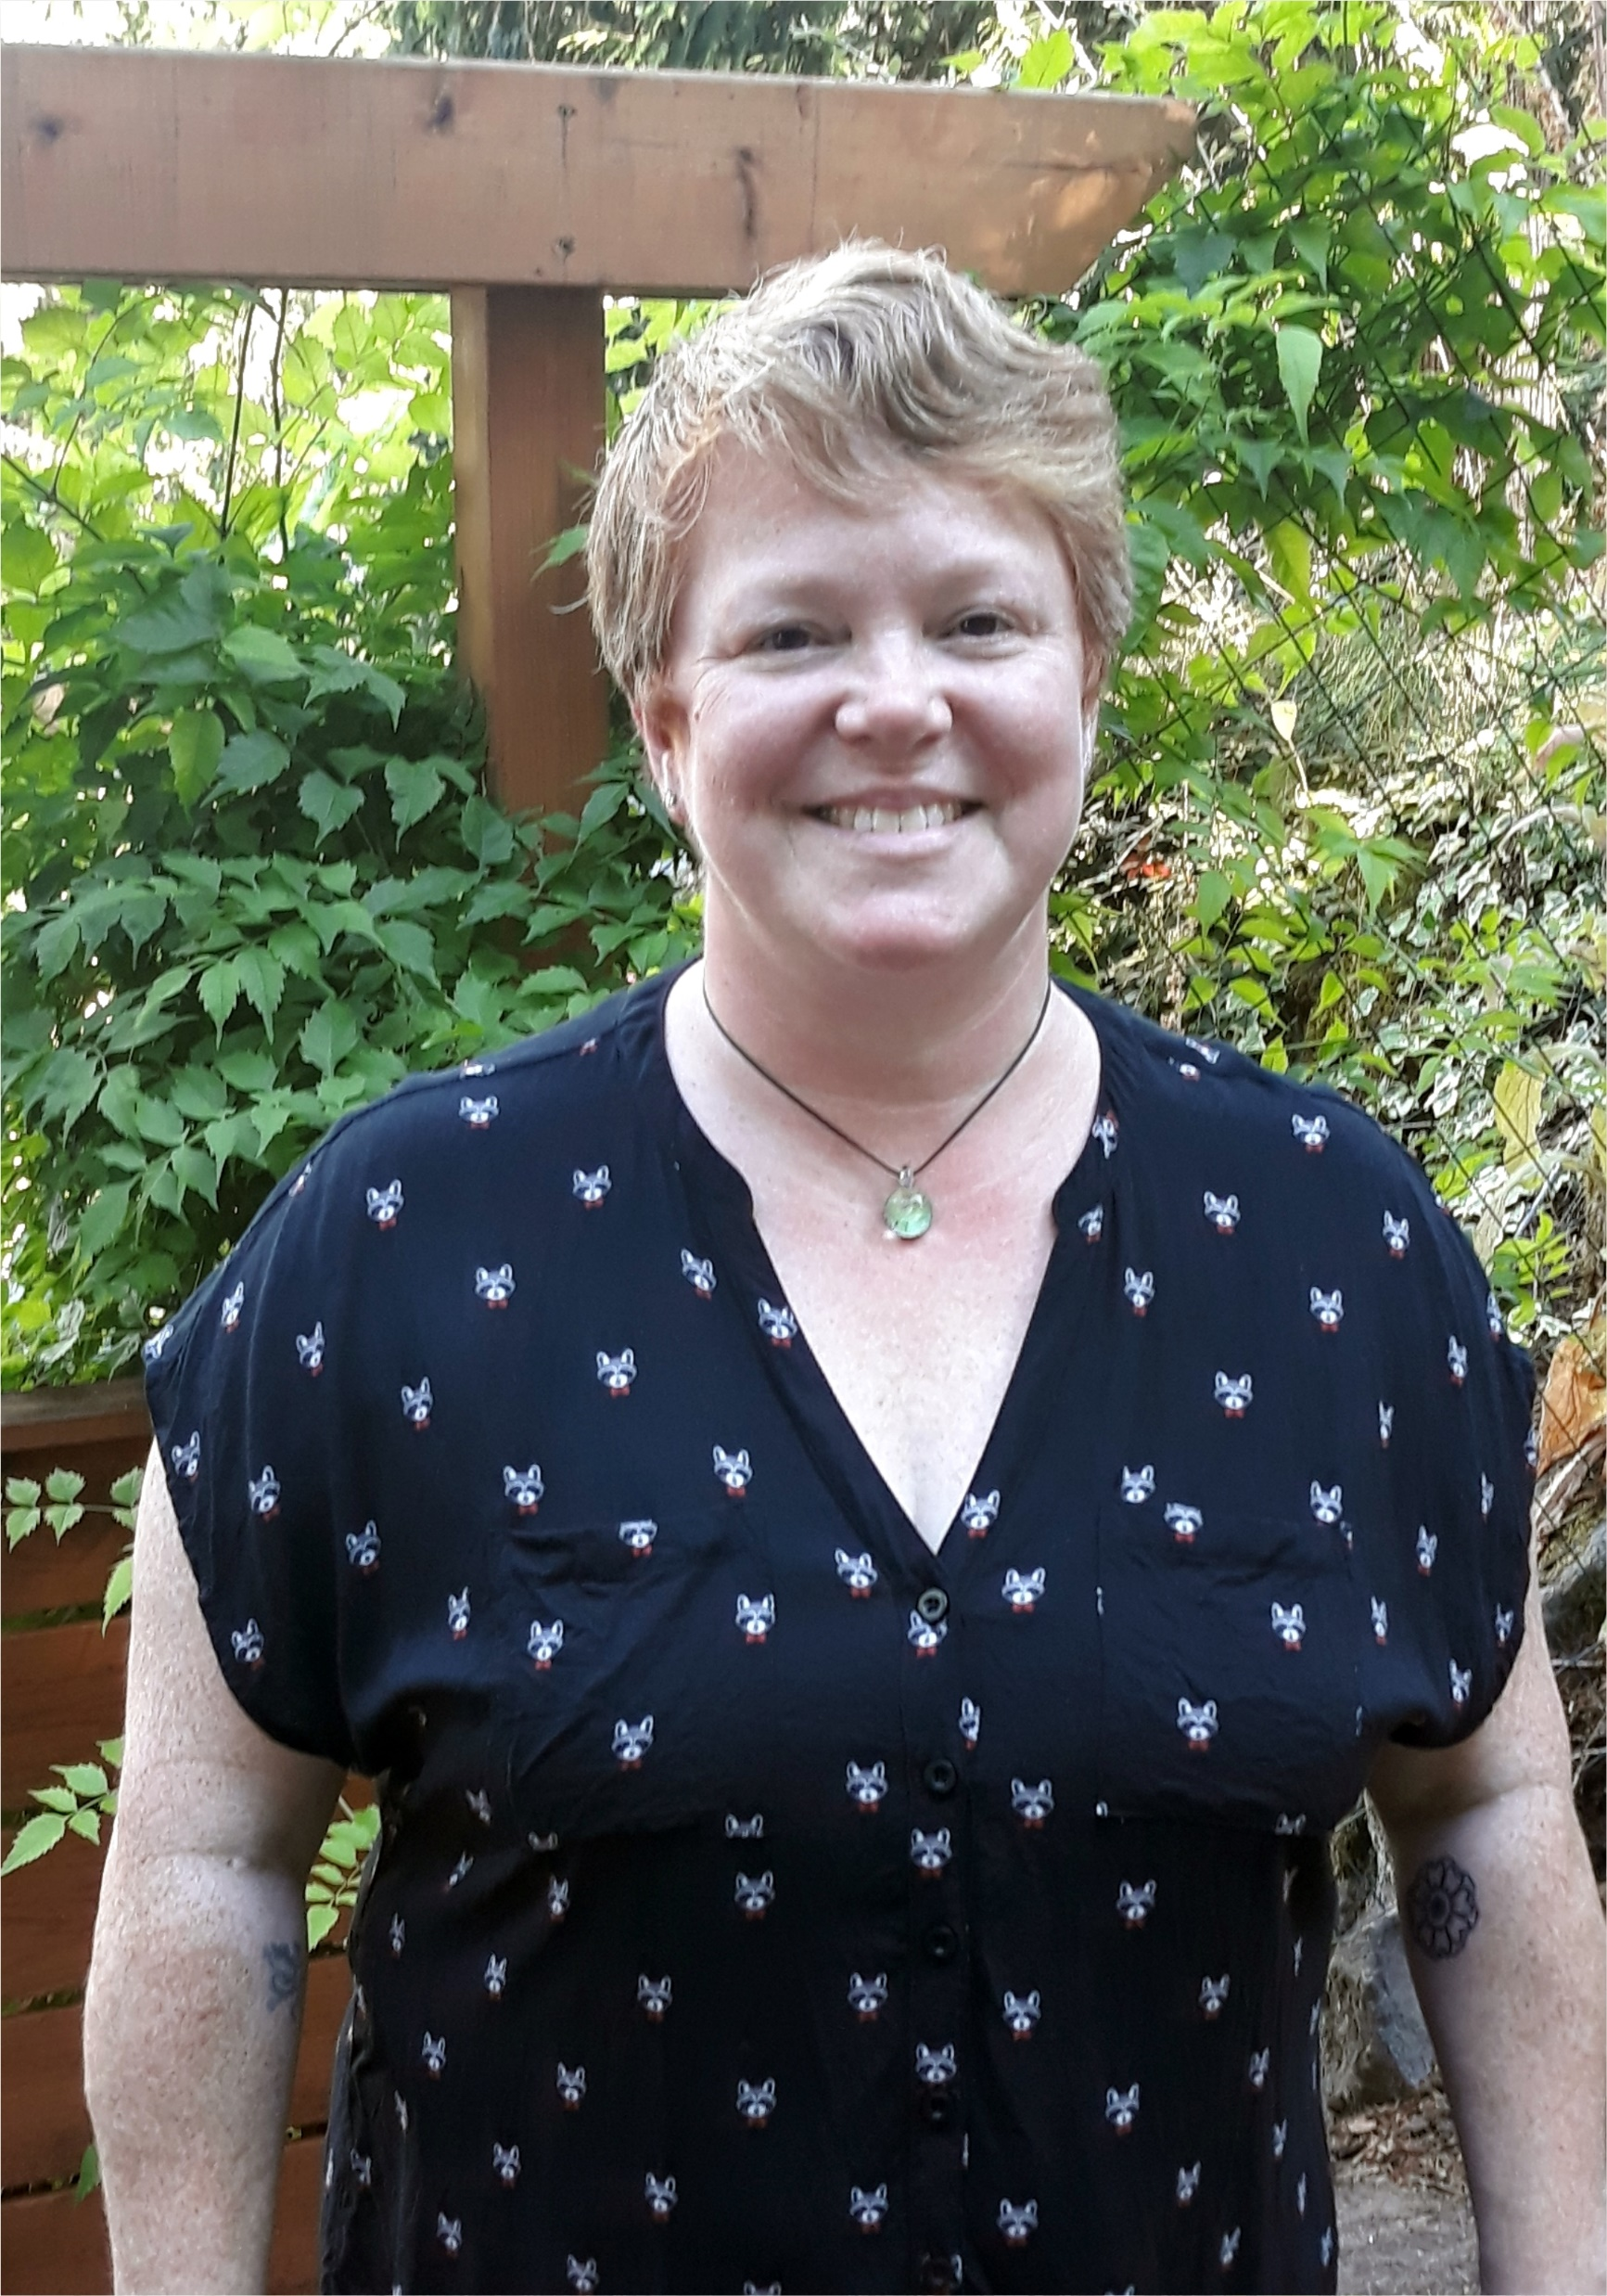
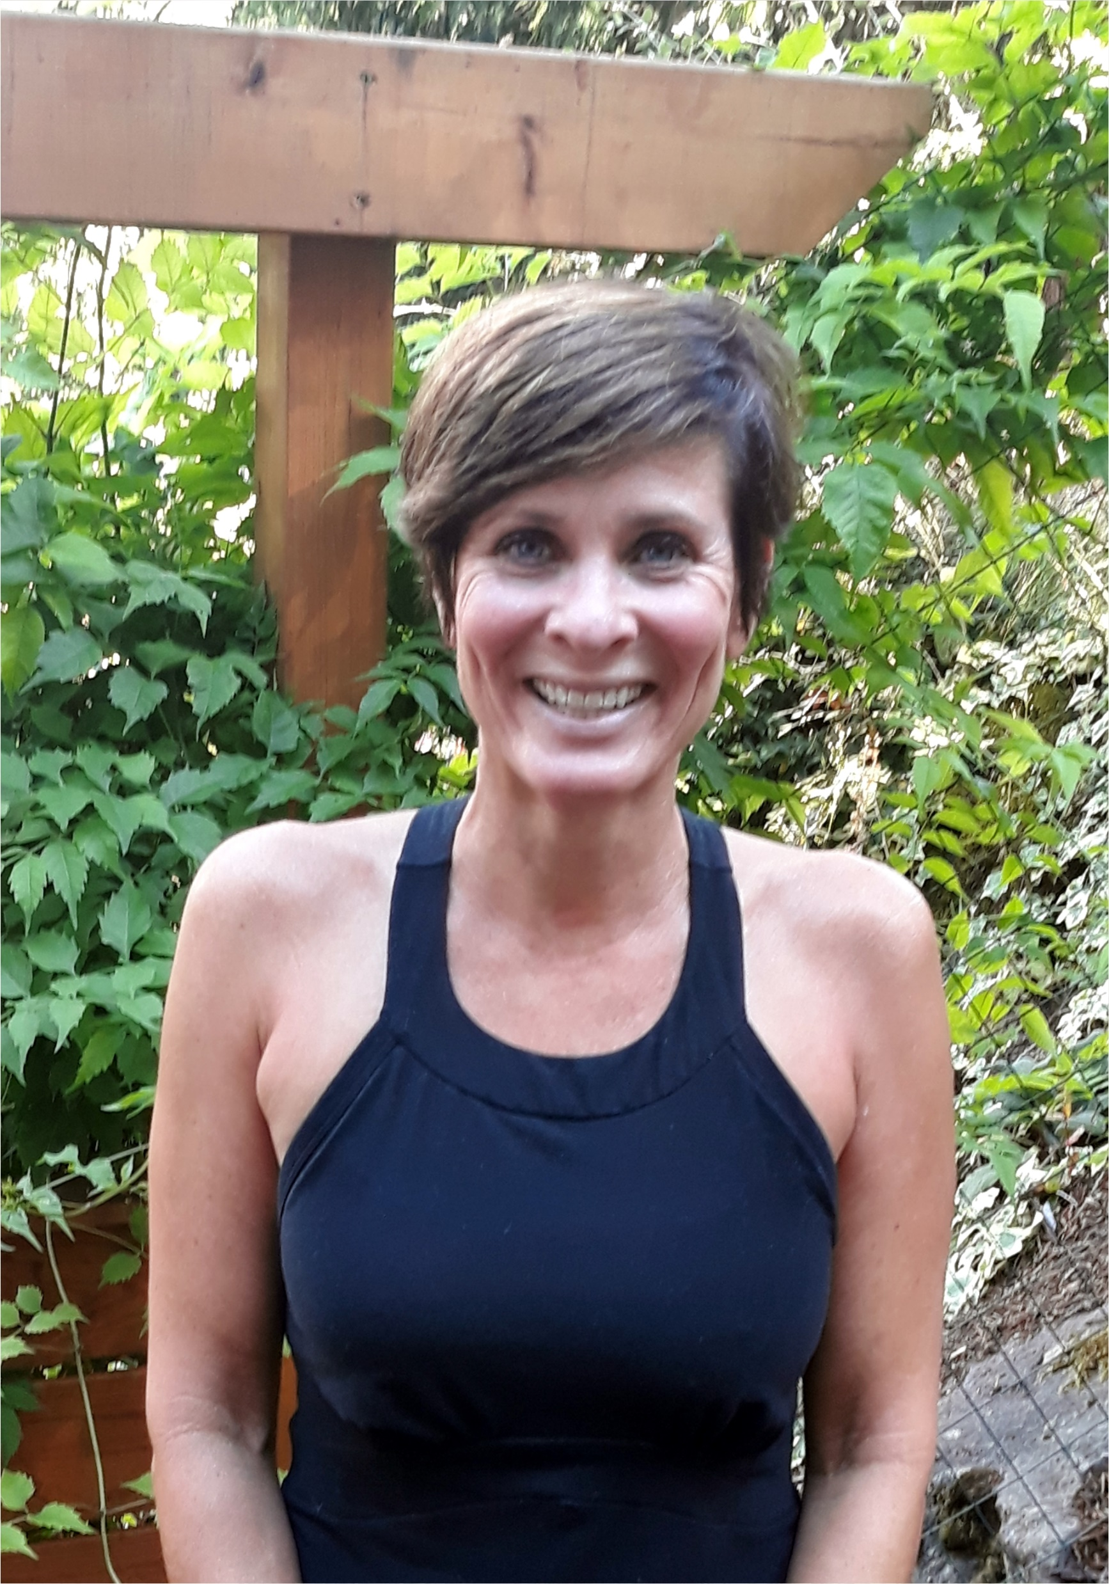
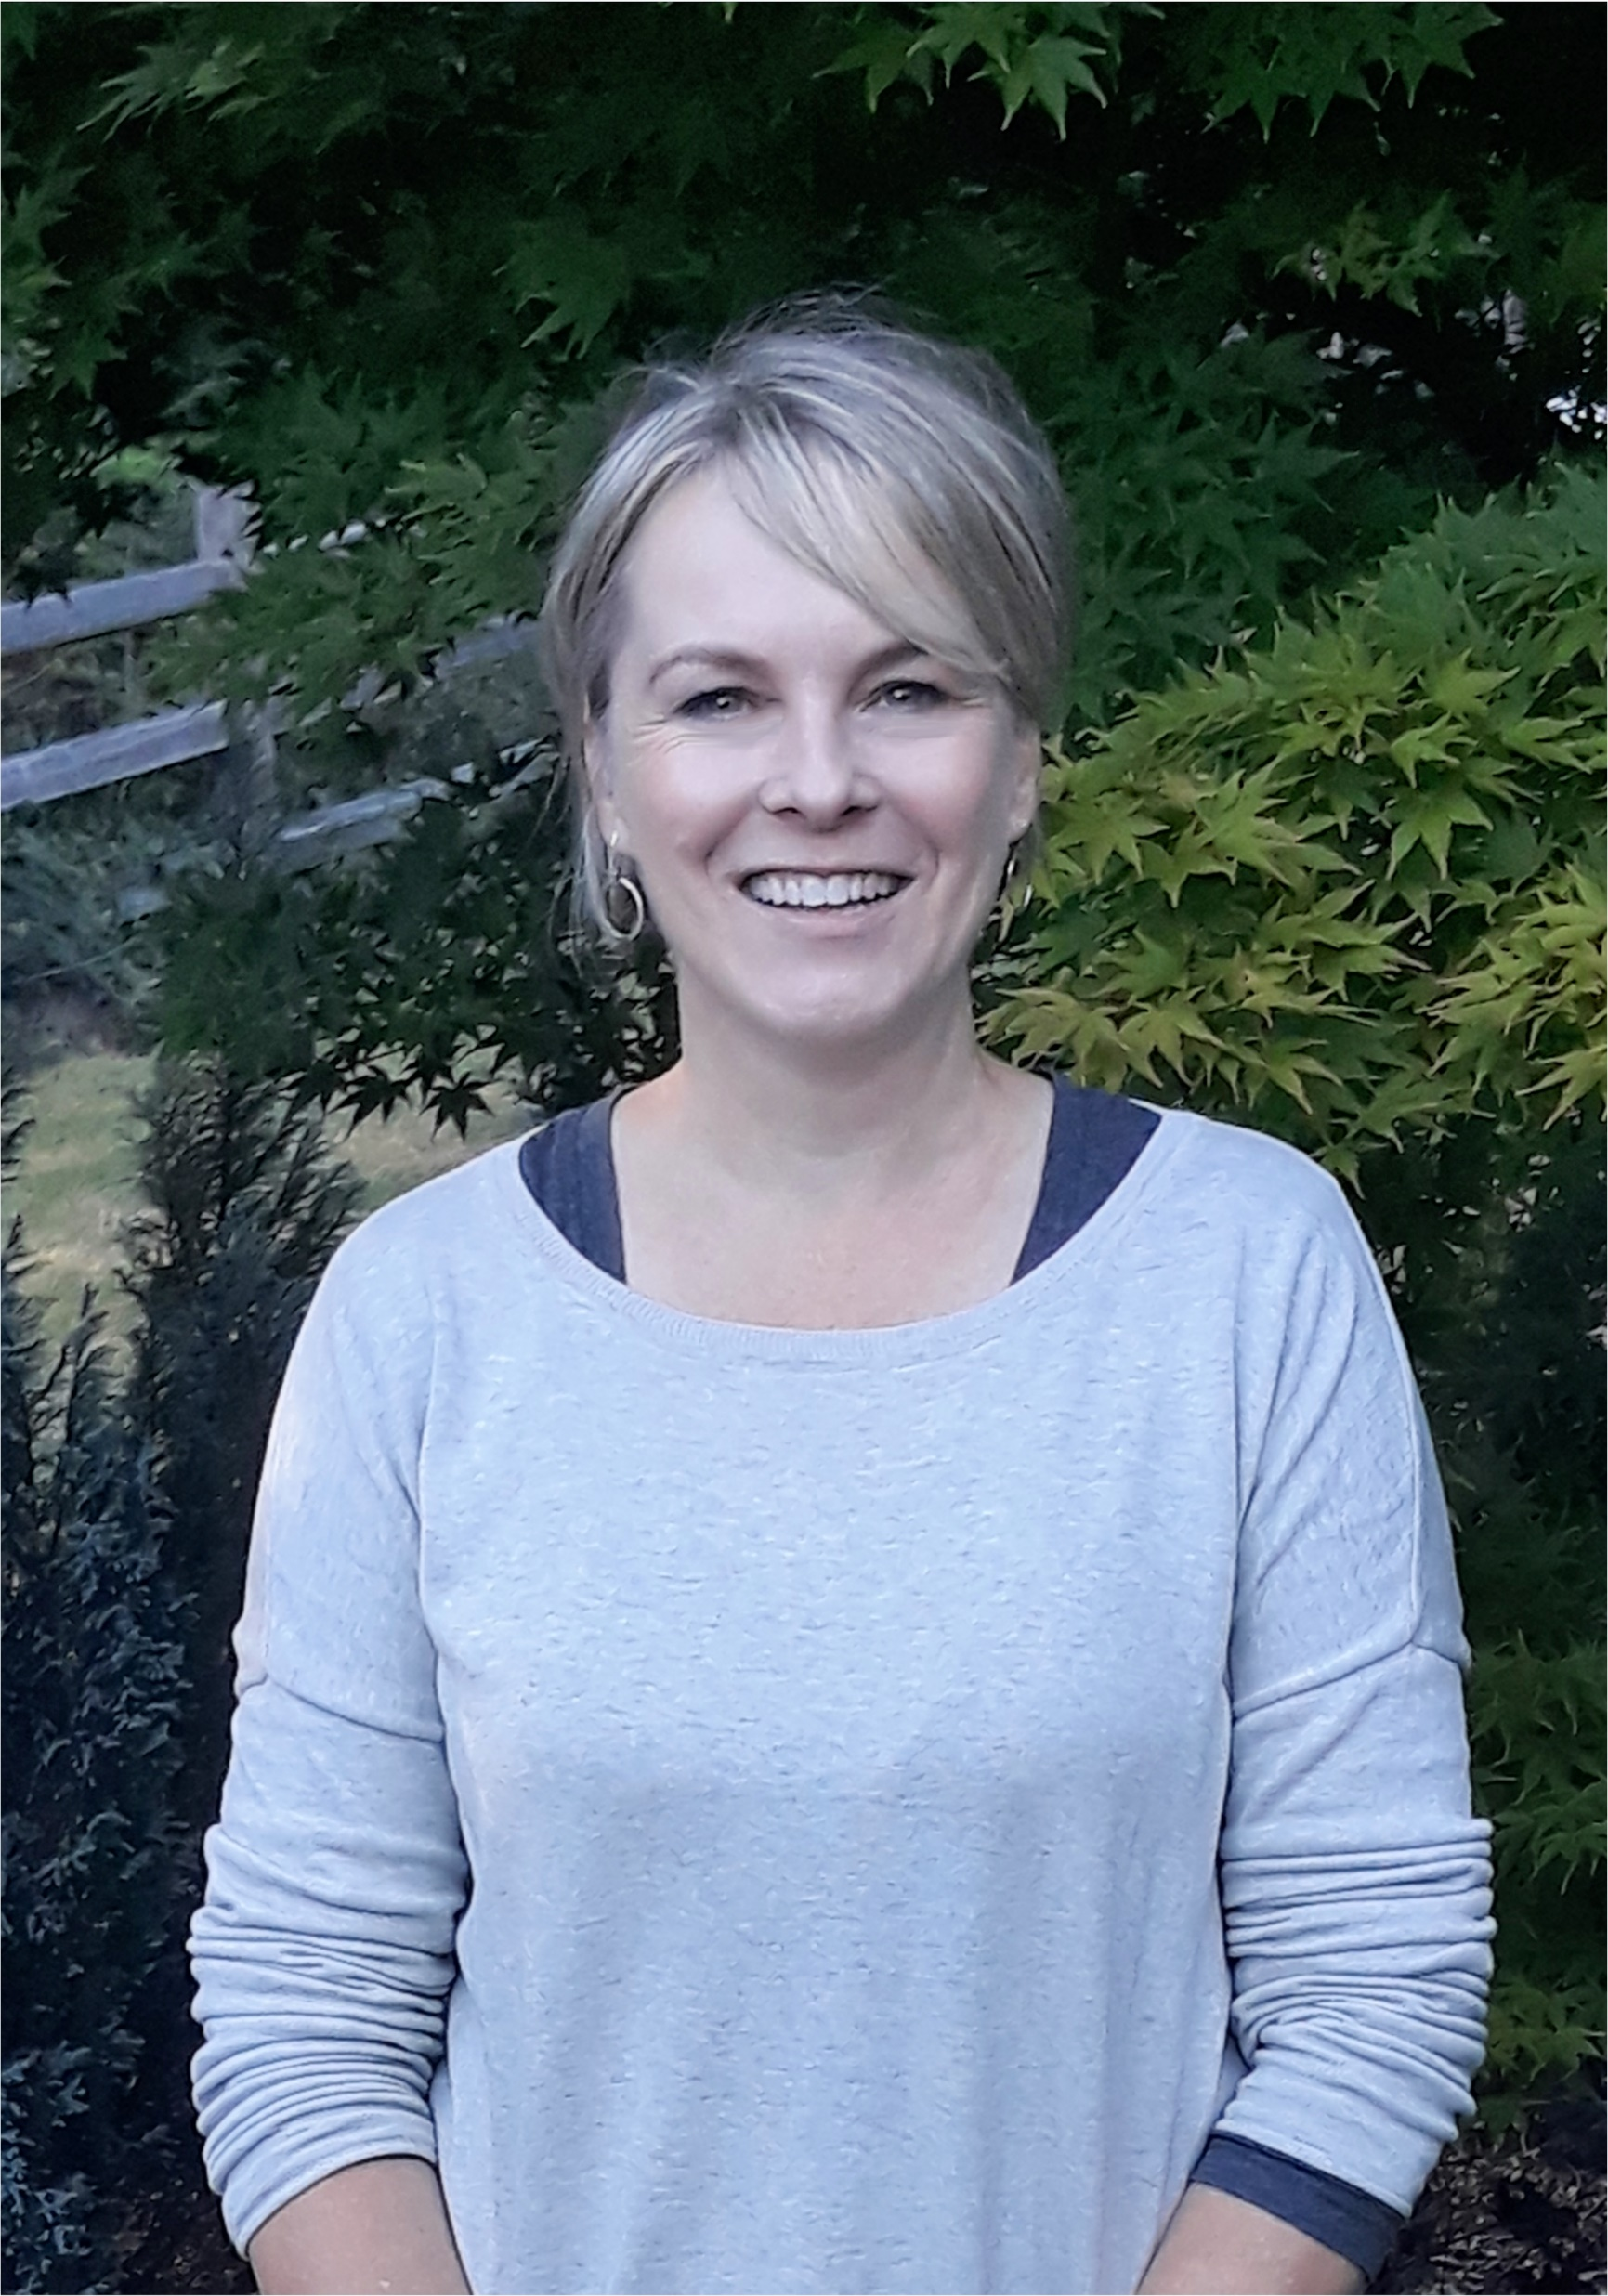
Welcome, from your ISD PTSA Reflections Co-chairs:
Leah Gibson
Kristen Allen-Bentsen
Heather Bratton

Slide 3
Welcome Reflections Chairs
Thank you so much for agreeing to chair your school’s annual Reflections arts recognition program. We, along with your school community, appreciate your time and leadership!
Please use this presentation as a guide and on-going reference as you move through your program. This overview contains:
National PTA Reflections program overview
School Chairs procedures, checklists, and general guidance
Contacts and resources

Slide 4
Special Circumstances during Remote Learning COVID-19
This presentation is designed as an overview of the typical sequence of Reflections events during a normal school year. Due to our remote learning environment, many of these steps will look different this year and some of the information may not currently apply.
Inserted throughout the presentation are Remote Learning suggestion slides. These will hopefully give you ideas and suggestion for how events might be presented this year.
Ensure a smooth process by deciding your 2020/21 method before you begin.
We are here to help with on-going support/communication as the year progresses and changes.
Thank you for reviewing the following information; join us for a Q and A on Sept 28.

Slide 5
National PTA Reflections Overview

Slide 6
What is Reflections?
Reflections is a National PTA arts recognition program that helps students explore their own thoughts, feelings and ideas, develop artistic literacy, increase confidence, and find a love for learning that will help them become more successful not only in school, but in life.
Students in pre-K through grade 12 create original works of art in response to an annual theme. Students submit their completed works of art in one, or more, of the available arts categories: Dance Choreography, Film Production, Literature, Music Composition, Photography, Visual Arts.
While the primary focus of Reflections is a celebration of creativity through positive recognition, 12 finalists from each school PTA will move on to our district council PTA; then finalists from our district will move on to the state round. Washington State PTA finalists who receive an “Outstanding Interpretation” award will advance to the National PTA round.

Slide 7
This year’s theme:
The theme is determined by National PTA from student submissions.
Interpretation of the theme is a very important part of the program; it represents 40% of the judge’s score and can be the determining factor when deciding which pieces move on to the next level of competition. Creative theme interpretation is encouraged!
(The due date for submitting a theme search entry is Nov. 1; see the state PTA website for more details.)

Slide 8
Categories:
A student may submit an entry in any of six arts areas. Following the state guidelines, each student may submit art in multiple categories, but only one piece in each category. Only original works of art are accepted. Detailed requirements are on the entry form. The six art areas are:
Literature – works of fiction and nonfiction in: poetry, prose, drama, short stories, essay, screen play, play script, narrative, and lyrics.
Music Composition – original musical composition, with or without words. Student may also be the performer, or one of the performers.
Photography - color or black/white single print (no collages) image in: photogram, negative sandwich, and multiple exposure.
Visual Arts - drawing, painting in various mediums, computer generated art, two-dimensional collage, printmaking, needlework & leather tooling, architectural drawing, ceramics, fashion drawing or clothing, fiber work, mixed media, and sculpture.
Choreography/Dance - originally choreographed solo and ensemble works al all dance styles. Student may also be the performer, or one of the performers.
Film/Video - original works, with or without sound, in: animation, narrative, documentary, experimental, or media.

Slide 9
Divisions:
Participation is organized by student age and grade level. Student works are critiqued against others in the same grade division. This allows recognition and judging of artworks by appropriate developmental age and skill levels.
The grade divisions are:
Primary: Preschool – Grade 2
Intermediate: Grades 3 – 5
Middle School: Grades 6 – 8
High School: Grades 9 – 12
Special Artist (allows for accommodations)
Each school will advance 12 pieces total (schools with 75 or more entries are allowed more pieces). Elementary Chairs will collect art for both Primary and Intermediate grades and send a mix of both for their combined total of 12. Special Artists are an exception as all submissions may advance to district. (More information following in the Chair Procedures and Guidance section of this presentation.)

Slide 10
Selection Criteria:
Judges consider the following criteria:
1. Interpretation: How closely the piece relates to the theme, based on the work itself and the artist statement.
2. Creativity: How creative and original the piece is in its conception of the theme and its presentation.
3. Technique: The level of skill demonstrated in the basic principles/techniques of the arts area.
Judges strongly consider the interpretation of the Reflections theme during the evaluation process. It is suggested that students give their submissions a title that stands out and describes how the piece relates to the student’s personal interpretation of the theme. The following guiding questions can be useful when developing a title and artist statement:
How does your work relate to the theme?
What is your personal connection to the theme?
What did you use to create your work (e.g., supplies, technology, instrumentation, props, etc.)?
What/who was your inspiration?

Slide 11
Qualifications:
Reflections is a National PTA arts contest open to students in grades pre-K through 12th grade. Although membership in a PTA is not required to enter, a Reflections program is a benefit of attending a school where there is a PTA. Students must enter the contest through a local grade-equivalent school PTA in good standing. A local PTA may, but is not required to, accept entries from students who do not attend its particular school (i.e. home-school students or students from schools where there isn’t a PTA). Note, families are welcome to join a school’s PTA, even if their children do not attend that school.

Slide 12
Chair Procedures and Guidance

Slide 13
Chair Responsibilities Overview
In this section we will walk you through the steps of running your program.
Here’s what we’ll cover:
Getting Started
Promoting Your Program
Organizing Artwork and Judging
Celebrating Your Participants
Wrapping Up and Reporting Success

Slide 14
Philosophy
A note about art advancement representation philosophy: You will advance 12 pieces to district. As chair, the make-up regarding divisions and categories is at your discretion. There are 2 ways to approach which pieces move on. Whichever one you choose, it is very important that you advertise your intention to families and judges before you collect art.
Approach #1 – Top Scores:
Advance your top 12 scores, regardless of the categories. For example, you would not advance a piece of literature simply because it was the only one submitted if you do not think it is outstanding work.
Approach #2 – Representative Sample:
Advance 12 pieces that are a rough percentage representation of all categories of art submitted. For example, if the majority of your art is Visual, you may choose to advance 7 of those and 1 each from other categories.

Slide 15
Remote Learning COVID-19
Due to our unique circumstances this year, in-person art collection and judging may be difficult or not an option for you.
You may choose to either handle art or conduct the entire program remotely. Decide which method you are intending before advertising to families and contacting judges so you can be clear on the timeline, procedure and expectations.
Completely Remote: Accept and judge entries electronically using photos of art. All communications at the school level are remote.
OR
Physically Handling Art:
Collect art in a safe manner and judges pass portfolio to each other.
More details in upcoming slides.

Slide 16
Getting Started
1. Register your PTA on the national site
5. Begin contacting potential judges
3. Prepopulate Student Entry Form and post on school site
4. Check school PTA Reflections budget
2. Set school calendar for turn-in date and celebration

Slide 17
Getting Started
Register your PTA on the national site
To officially enter, your school PTA needs to register on the National PTA site. http://www.pta.org/home/programs/reflections
Have this information handy when you start the process:
Official PTA Name
8-digit ID (can access on the site)
School mailing address
Student Enrollment*
Title 1 and Free/Reduced Lunch percentages*
* See next slide.

Slide 18
SCHOOL | UNIT # | LOCAL ID | NATIONAL ID | ENROLLMENT | % OF FREE/REDUCED | TITLE ONE SCHOOL?
Apollo | 2.6.3 | 00206003 | 00023813 | 614 | 14.7 | Yes
Beaver Lake | 2.6.33 | 0206033 | 00032345 | 846 | 3.0 | No
Briarwood | 2.6.5 | 0206005 | 00023190 | 730 | 10.11 | Yes
Cascade Ridge | 2.6.2 | 0206002 | 00019529 | 494 | 1.5 | No
Challenger | 2.6.6 | 0206006 | 00023243 | 594 | 6.8 | No
Clark | 2.6.7 | 0206007 | 00006909 | 783 | 18.9 | Yes
Cougar Ridge | 2.6.8 | 0206008 | 00025016 | 568 | 2.7 | No
Creekside | 2.6.4 | 0206004 | 02636248 | 733 | 9.3 | No
Discovery | 2.6.9 | 0206009 | 00027342 | 708 | 1.6 | No
Endeavor | 2.6.20 | 0206020 | 00033714 | 588 | 9.6 | No
Gibson Ek | 2.6.60 | 0206060 | 04531793 | 187 | 6.5 | No
Grand Ridge | 2.6.10 | 0206010 | 00387755 | 726 | 5.3 | No
Issaquah High | 2.6.45 | 0206045 | 00028342 | 2494 | 7.4 | No
Issaquah Middle | 2.6.35 | 0206035 | 00023152 | 1008 | 11.5 | No
Issaquah Valley | 2.6.11 | 0206011 | 00025821 | 627 | 21.9 | Yes
Liberty | 2.6.50 | 0206050 | 00026132 | 1475 | 9.3 | No
Maple Hills | 2.6.15 | 0206025 | 00023189 | 422 | 8.3 | Yes
Maywood | 2.6.40 | 0206040 | 00023186 | 1233 | 3.6 | No
Newcastle | 2.6.18 | 0206018 | 00256624 | 617 | 4.8 | No
PCMS | 2.6.41 | 0206041 | 02636848 | 1024 | 2.7 | No
Pine Lake | 2.6.42 | 0206042 | 00016129 | 949 | 2.9 | No
Skyline | 2.6.70 | 0206070 | 00010701 | 2245 | 3.8 | No
Sunny Hills | 2.6.25 | 0206025 | 00023095 | 796 | 3.7 | No
Sunset | 2.6.30 | 0206030 | 00023097 | 652 | 7.6 | No
2020/21
Demographic Information by School :

Slide 19
Getting Started
Set school calendar for turn-in date and celebration
Work backward from the district turn-in date to set your school dates. (Calendar on next slide.)
Consult your school secretary and other pertinent parties to ensure facility availability.
Your dates should include:
Artwork due date
Allow plenty of time for judging before our district November turn-in date. Note, most schools choose an end of October due date.
Many schools publish a ‘soft’ date with a hard date in mind to build in a cushion since kids forget/are sick/etc.
Judging date/days
As chair you can determine how you will host judging. (i.e. one evening event, over several days, etc.)
You can use different formats for different categories. (i.e. send digital pieces like dance to the judges electronically, while hosting visual art piece judging at the school.)
Recognition/Celebration
These vary by school. Past ideas: art walks, student receptions, on-going wall displays, photos on website, incorporation with other school events.
Note, pieces advancing to district cannot be returned to you until after the January District Reception (or later if they move onto the state level). Please do not plan to use the artwork for a celebration after the November district turn-in date (even if you have been allowed to do this in the past).

Slide 20
Getting Started
Set school calendar for turn-in date and celebration
Important Dates:
Leader Material Available on State Website Aug
Fall Chair Training Q and A (this presentation) Sept 28
Individual School Turn-in Date TBD by you
Individual School Judging TBD by you
Individual School Recognition/Celebration TBD by you
Enter school winners into district database by Nov 11
District Turn-in Date Nov 16
District Judging Nov
District Reflections Reception/Art Return TBD
State Turn-in Date Jan 22
State Awards Announced April/May
State Art Returned to Students May

Slide 21
Getting Started
Prepopulate Student Entry Form and post on school site
Each art piece needs to be accompanied by the ‘Entry Form – Washington’ found at the end of the Student Entry Packet. Follow these steps to make sure your forms are complete and eligible. We cannot accept artwork to proceed to the district level for judging with incomplete forms. Prepopulating the forms before posting to your site or distributing will make everything much easier for you and your families.
Go to www.wastatepta.org/events-programs/reflections/
Explore the Reflections area. Here you can find logo material, forms, checklists, handbook, etc.
Locate a generic form in the Student Entry Packets tab in the Leadership section. The last packet page is the same for all categories and can be used by all students. This is the only page that needs to accompany each piece.
Fill out the top of the first and the ENTIRE top section of the last page with your school and contact information.
Contact your treasurer for requested paid dates.
If your school does not yet have these dates, use an estimate based on last year. (i.e. Dec 1)
Provide contact information for yourself that you will use for the remainder of the year.
Post prepopulated entry forms on your school PTA site and wherever else your families access Reflections information.

Slide 22
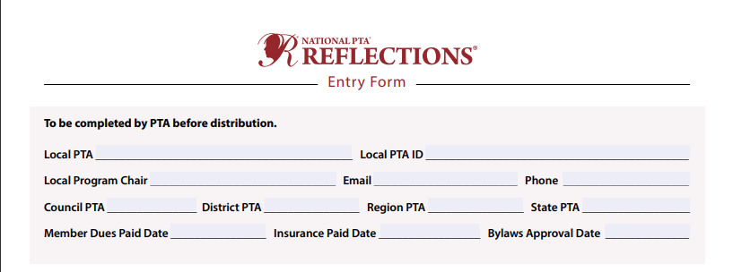
Getting Started
Prepopulate Student Entry Form and post on school site
Complete these 2 sections before posting to your school sites. Doing this ahead of time ensures you will not have to fill it in multiple times for those advancing to district or be disqualified for an incomplete packet at the state level.

Slide 23
Getting Started
Check school PTA Reflections budget
Reflections is an annual program, and your school should have a line item in their budget.
Common expenses are:
Participation ribbons and certificates
Reception refreshments
Reception/display decorations
Misc. art supplies, mounting material, page protectors, and cellophane wrapping
Tokens of appreciation for judges
X-Large heavy-duty art portfolio if you don’t currently have one or need a new one

Slide 24
Getting Started
Begin contacting potential judges
Each category needs judges with experience in that artform to assess your students’ entries. If they are not a professional in the medium, they should have depth of experience/skills/knowledge. Begin identifying past and potential new judges and provide them your dates.
Factor time in your calendar schedule between judging and the district turn-in date to ready artwork that is moving on.
If you cannot find judges for each category, contact us for help. (Note, you may not need judges for every category.)
(More on judging in an upcoming slide.)

Slide 25
Promoting Your Program
Use all your school’s methods of communication to advertise Reflections and promote the program.
Link program rules and student entry form as much as possible.
Theme logo graphics can be found on the state and national websites.
Word of mouth
Bulletin boards
PTSA Facebook, Twitter, Instagram
School newsletter/ e-news
PTSA and school websites
Peachjar/ e-flyers
Lunch announcements

Slide 26
Promoting Your Program
While encouraging students to participate here are some things to emphasize:
Copyright infringement and any form of plagiarism will disqualify a piece.
The importance of interpreting the theme. Interpretation is worth 40% of the judge’s score and often is a tie-breaker when deciding which piece will more onto the next level.
A strong title can greatly enhance a piece. Encourage students to use a title other than just stating the theme.
Artwork needs to be an original concept wholly imaged by the student and is therefore not suitable for whole class art lessons or docent lessons. Using a learned technique or style is fine, submitting something a group did together under direct instruction is not.
Some PTAs provide time outside of class (i.e. during lunch or after school) for students to work on projects and/or make supplies available for students who do not have these resources at home.

Slide 27
Remote Learning - Collecting art COVID-19
Due to our unique circumstances this year, collecting art may be difficult or not an option for you.
Here are some suggestions for collecting art. Clearly communicate your collection method when advertising your program:
Completely Remote:
Students submit art to you digitally. Families send you a photo of the artwork and accompanying entry form. You will send these to the judges. Once your 12 finalists are selected, you will need to collect the physical art for those 12 only to deliver to us on Nov 16.
OR
In-person:
Collect physical art in a safe manner (distancing, masks, outside); perhaps outside in a central location during a set window of time. You will then transfer art to judges in your portfolio, which will be passed from judge to judge. (Build enough time for this in your schedule.)

Slide 28
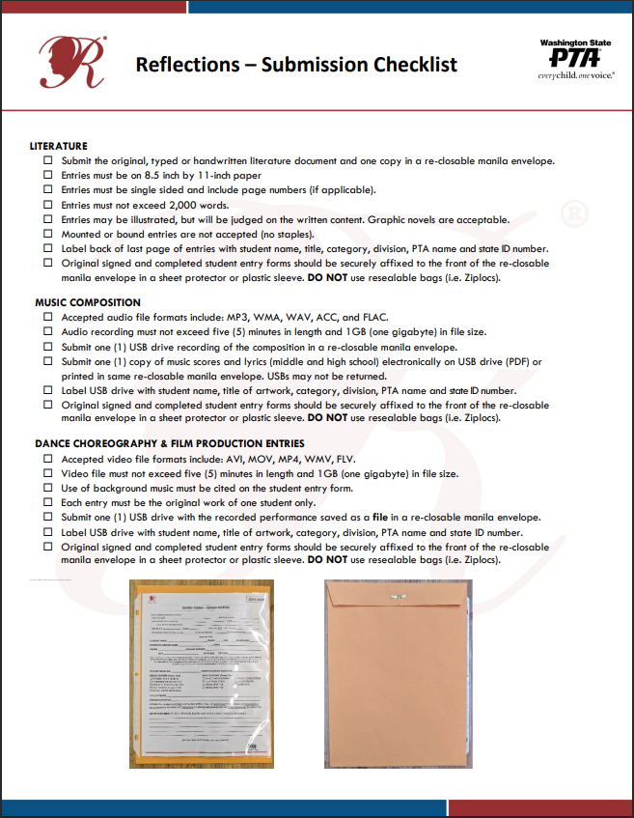
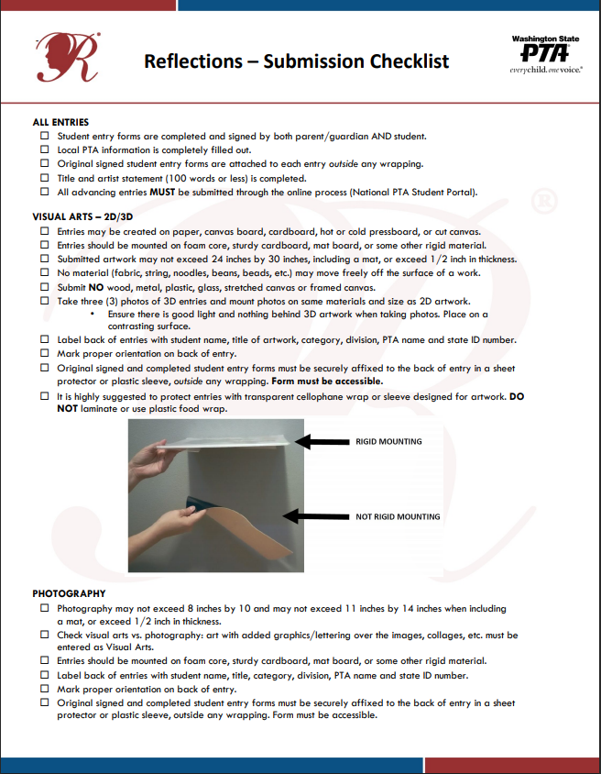
Organizing Artwork for Judging
As students turn in art, review each piece to make sure it meets the category submission requirements. These details are found in the student entry packet for each category.
Use the Submission Checklist found HERE
At turn-in review for:
Completed Entry Form and signatures
Legible Artist Statement
Obvious disqualifications (i.e. size, framing, thickness, etc.)
Copyright infringement, plagiarism, etc.
Correct labeling on back of piece, correct media file format
After turn-in:
Organize work by Category and Division
Confirm needed judges
Prepare judging packets or electronically send forms to judges

Slide 29
Remote Learning - Judging art COVID-19
Due to our unique circumstances this year, judging art will be conducted different than usual.
Due to a tighter timeframe, you may want to limit the number of judges you use this year. (If you have 12 or fewer pieces overall, or few in a single category, you may choose to pass those straight to district and forego judging.)
Schools are not conducting group in-person judging this year. Here are suggestions for alternatives:
Completely Remote:
Send digital photos of the artwork, artist statement, directions and scorecards to judges. Once your 12 finalists are selected, you will need to collect the physical art for those 12 only to deliver to us on Nov 16.
OR
Physically Handling Art:
Judges pass portfolio of art relay-style to each other. Collecting their feedback could be either on physical forms they include in the portfolio or electronically to you. Build enough time for this in your schedule. Once your 12 finalists are selected, you will bring those pieces to us on Nov 16.

Slide 30
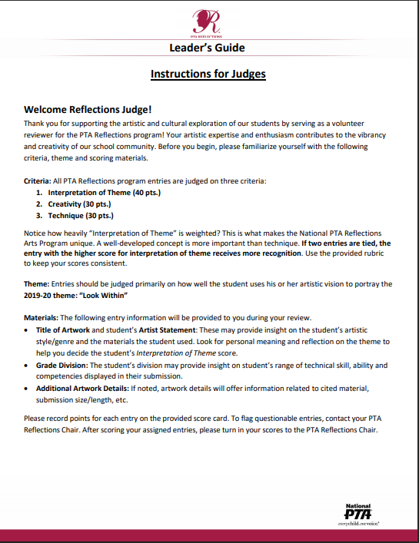
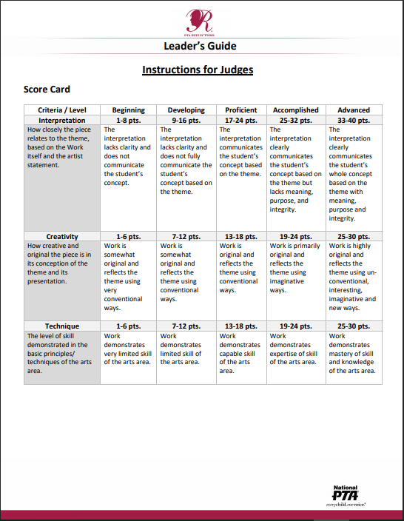
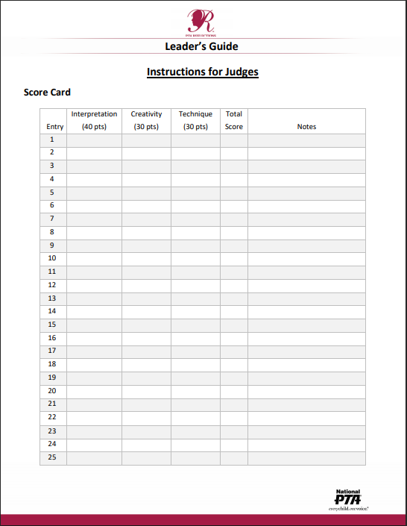
Judging
Judge directions and scorecards can be found HERE and in the Leader’s Resources section at wastatepta.org
Suggestions for smooth judging:
If multiple judges are using the same space, arrange for flow and stagger judging times.
If using scorecards, provide clipboards and pencils.
Make Artist Statements accessible and attached.
Pieces must be anonymous – cover names on art and do not display entry forms.
At elementary level, judge Primary pieces first, then Intermediate.
If artists receive judge’s comments, make sure this is clear to judges.

Slide 31
Post Judging
After judging:
Decide which 12 pieces will advance to District. (Schools with 75+ entries are allowed 15 to advance, 100+ entries have 18 advance.)
Register your 12 submissions into http://ptareflections.fluidreview.com/ and print a screenshot when all entries have been entered.
Register your 12 submissions into our site HERE by Nov 11th.
Send thank you/token of appreciation to judges.
Review Submission Checklist (found HERE) to double check that all works meet guidelines.

Slide 32
Remote Learning - Submitting art to district COVID-19
Due to our unique circumstances this year, collecting your art will be conducted different than usual. Follow these steps to ensure your artwork will be qualified.
Complete all steps on slides 31-36. Due to the circumstances this year, we need everything submitted on both electronic sites and properly prepared before drop-off or we cannot judge it.
Bring your portfolio and 12 pieces to us on November 16th. (Location, time frame, and phone contact will be sent to you closer to date). We will collect your art from your vehicle in front of the building. We will check that your portfolio is complete after you drop it off. You will not have an opportunity at drop-off to make corrections or electronic data base submissions.

Slide 33
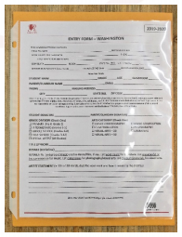
District Turn-in
Bring advancing pieces on date to designated turn-in place in your school’s sturdy portfolio. (If you do not have a portfolio in usable condition work with your PTA for funding to purchase a new one; contact us if this is not an option.) If you cannot bring your art during the designated time contact us.
Each piece needs the following:
Entered into National PTA portal http://ptareflections.fluidreview.com/
Entered into district database HERE (see next slide)
Completed entry form visible and attached to back of art or manila envelope (in page protectors preferred)
Art correctly labeled on back - visual art and photography (see checklist for details)
USB drives correctly labeled (see checklist for details)
Visual art correctly mounted and wrapped in cellophane (see next slides)

Slide 34
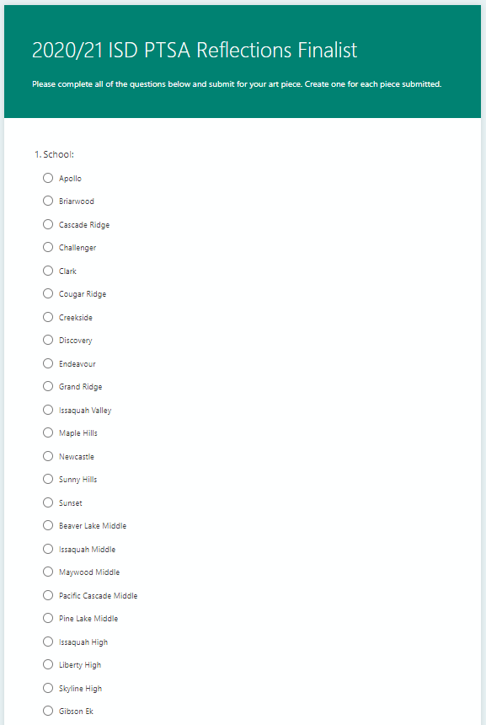
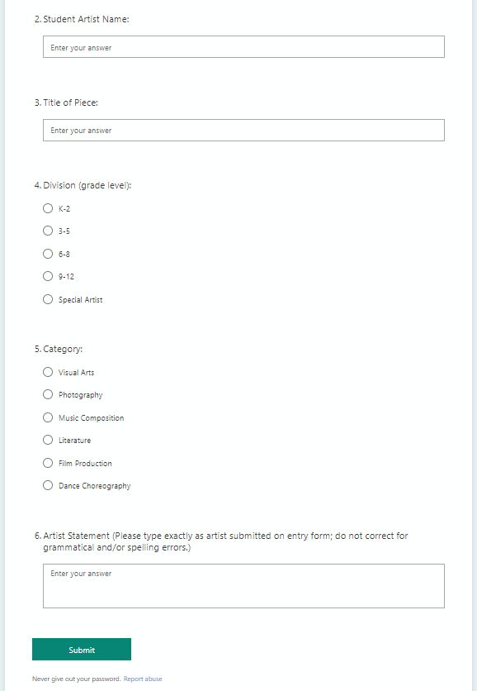
District Turn-in
Enter each entry into district database HERE
Complete this step before bringing art to district collection site.

Slide 35
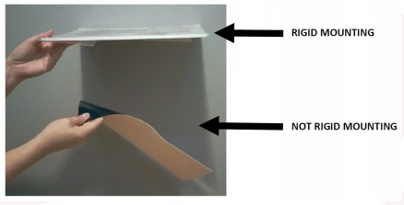
District Turn-in
Correctly mount Visual Art and Photography. Must be rigid to qualify.
Does not bend when held by corner: i.e. foam core, very thick poster board, photo matting, very thick cardboard
RIGID MOUNTING
Sags when held by corner
NOT RIGID MOUNTING

Slide 36
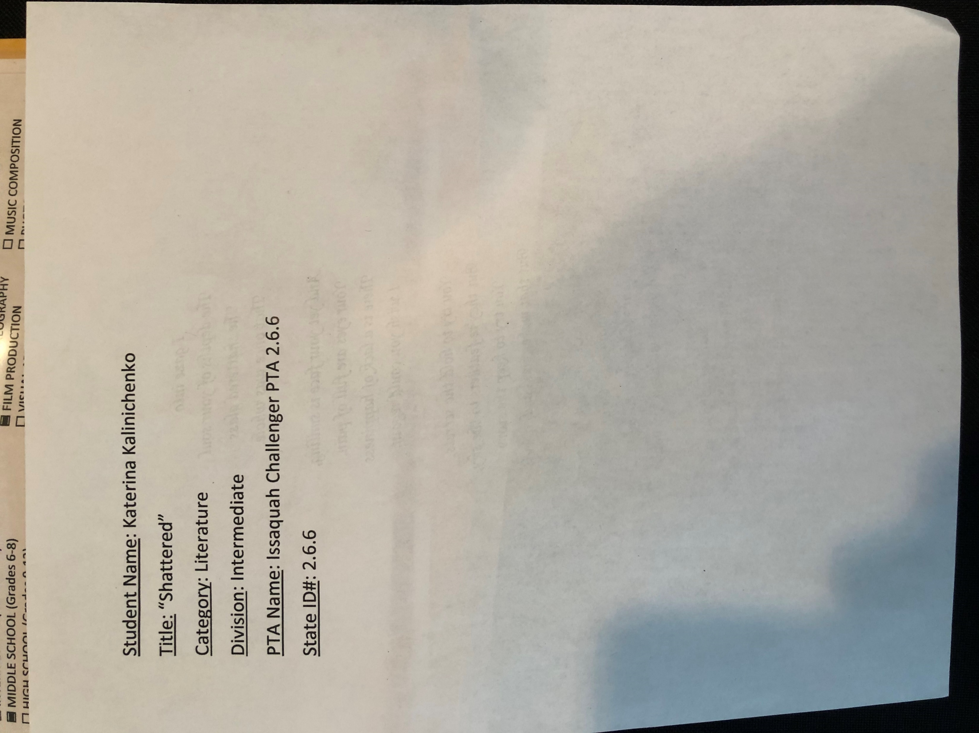
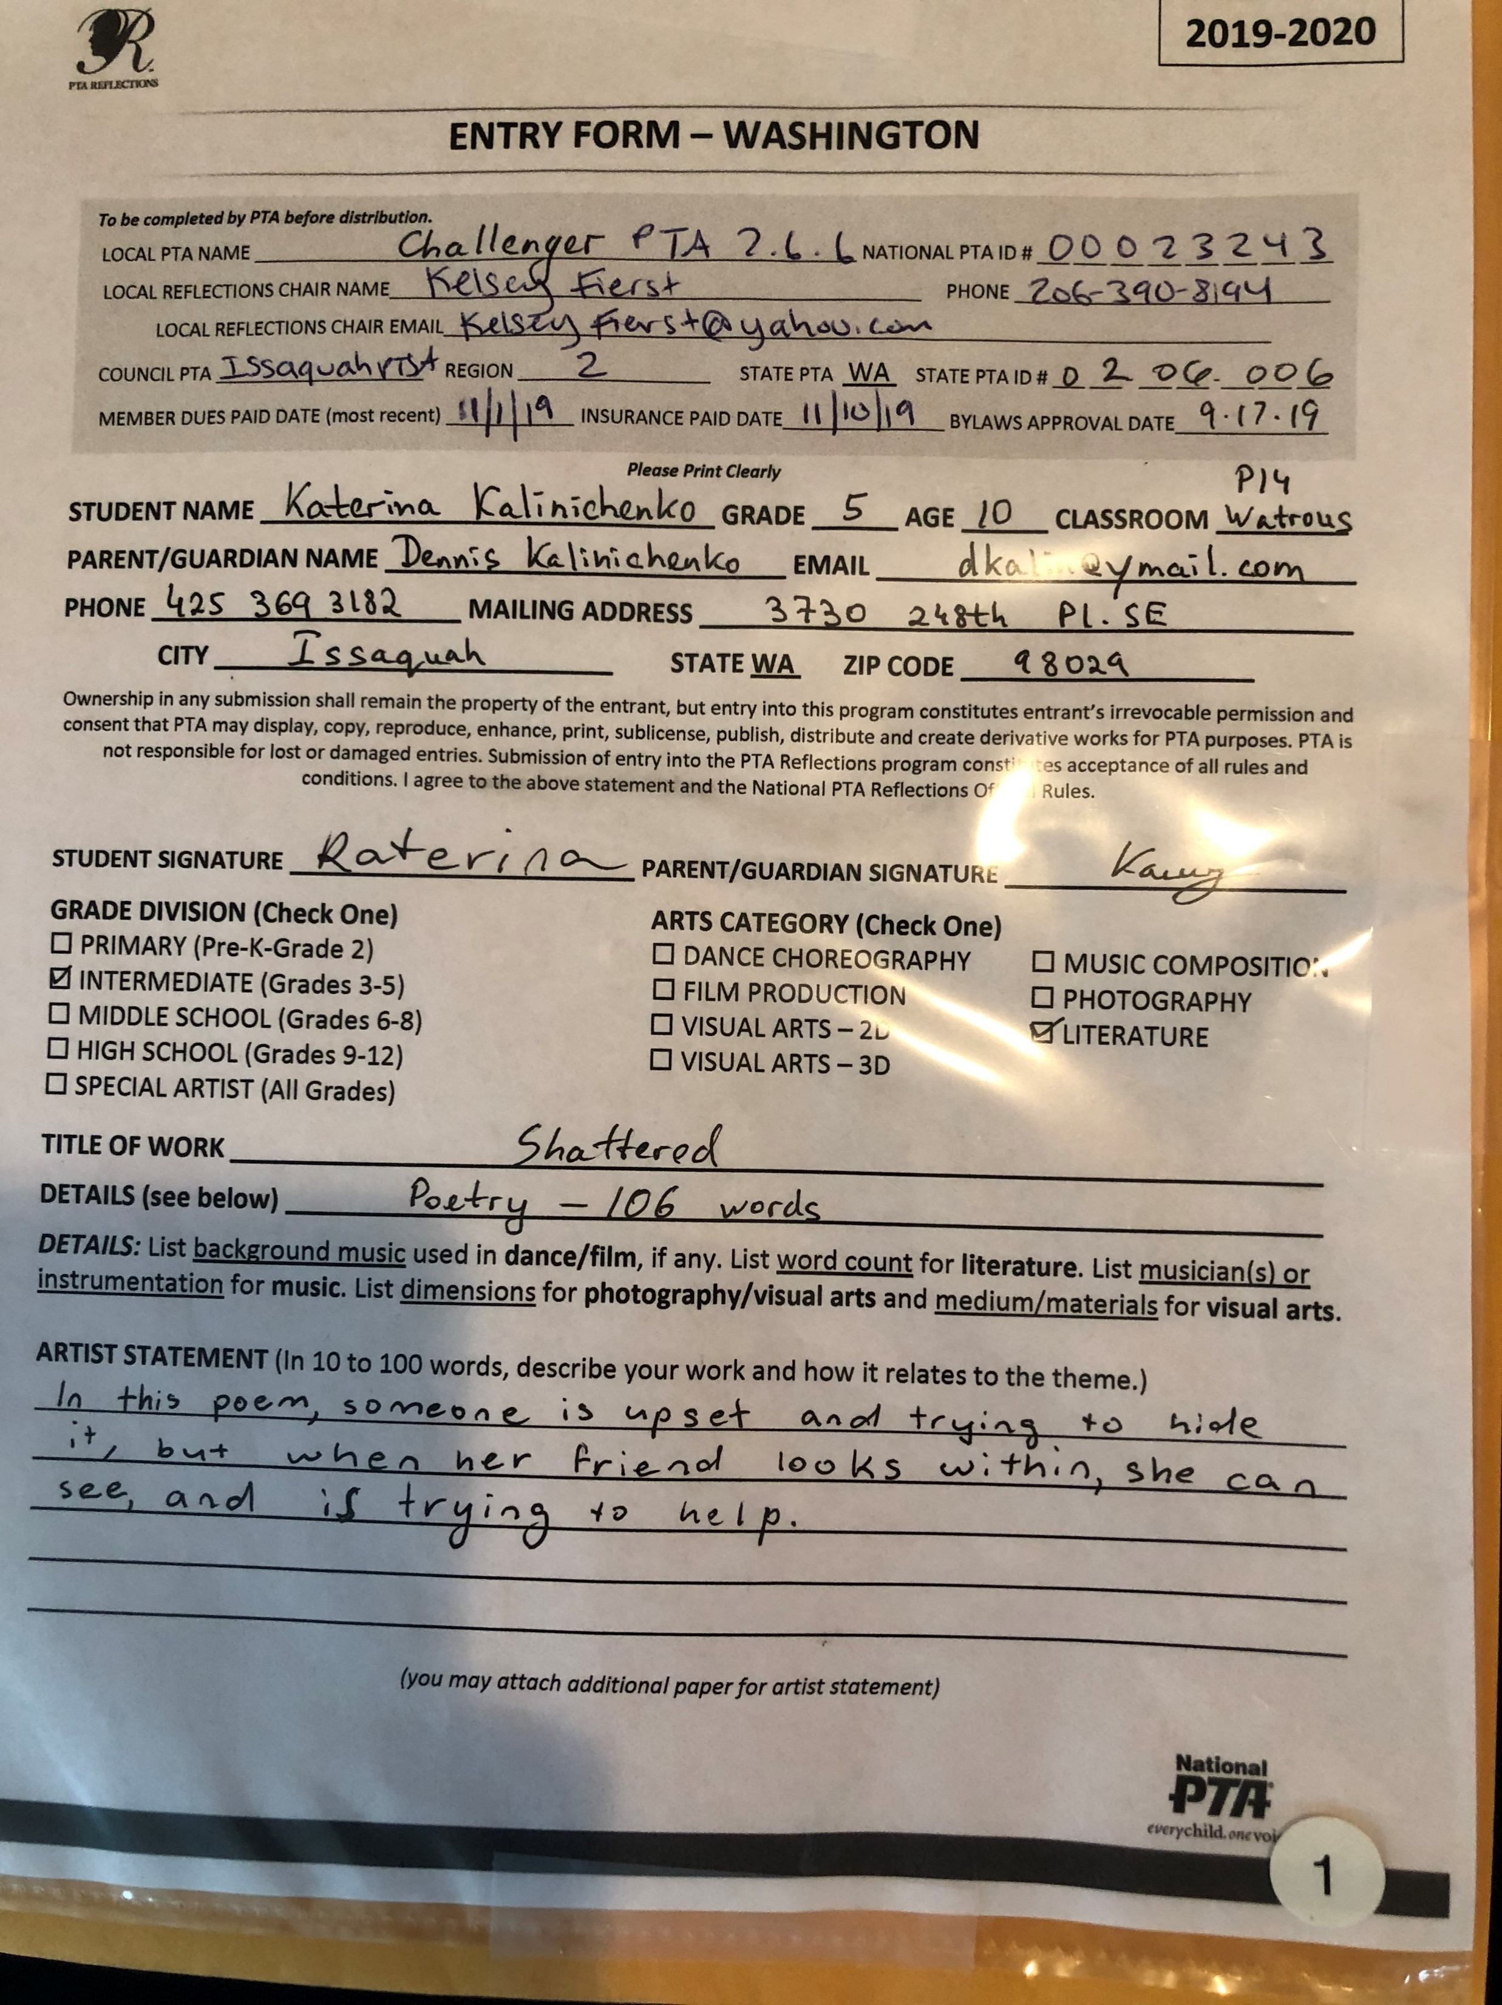
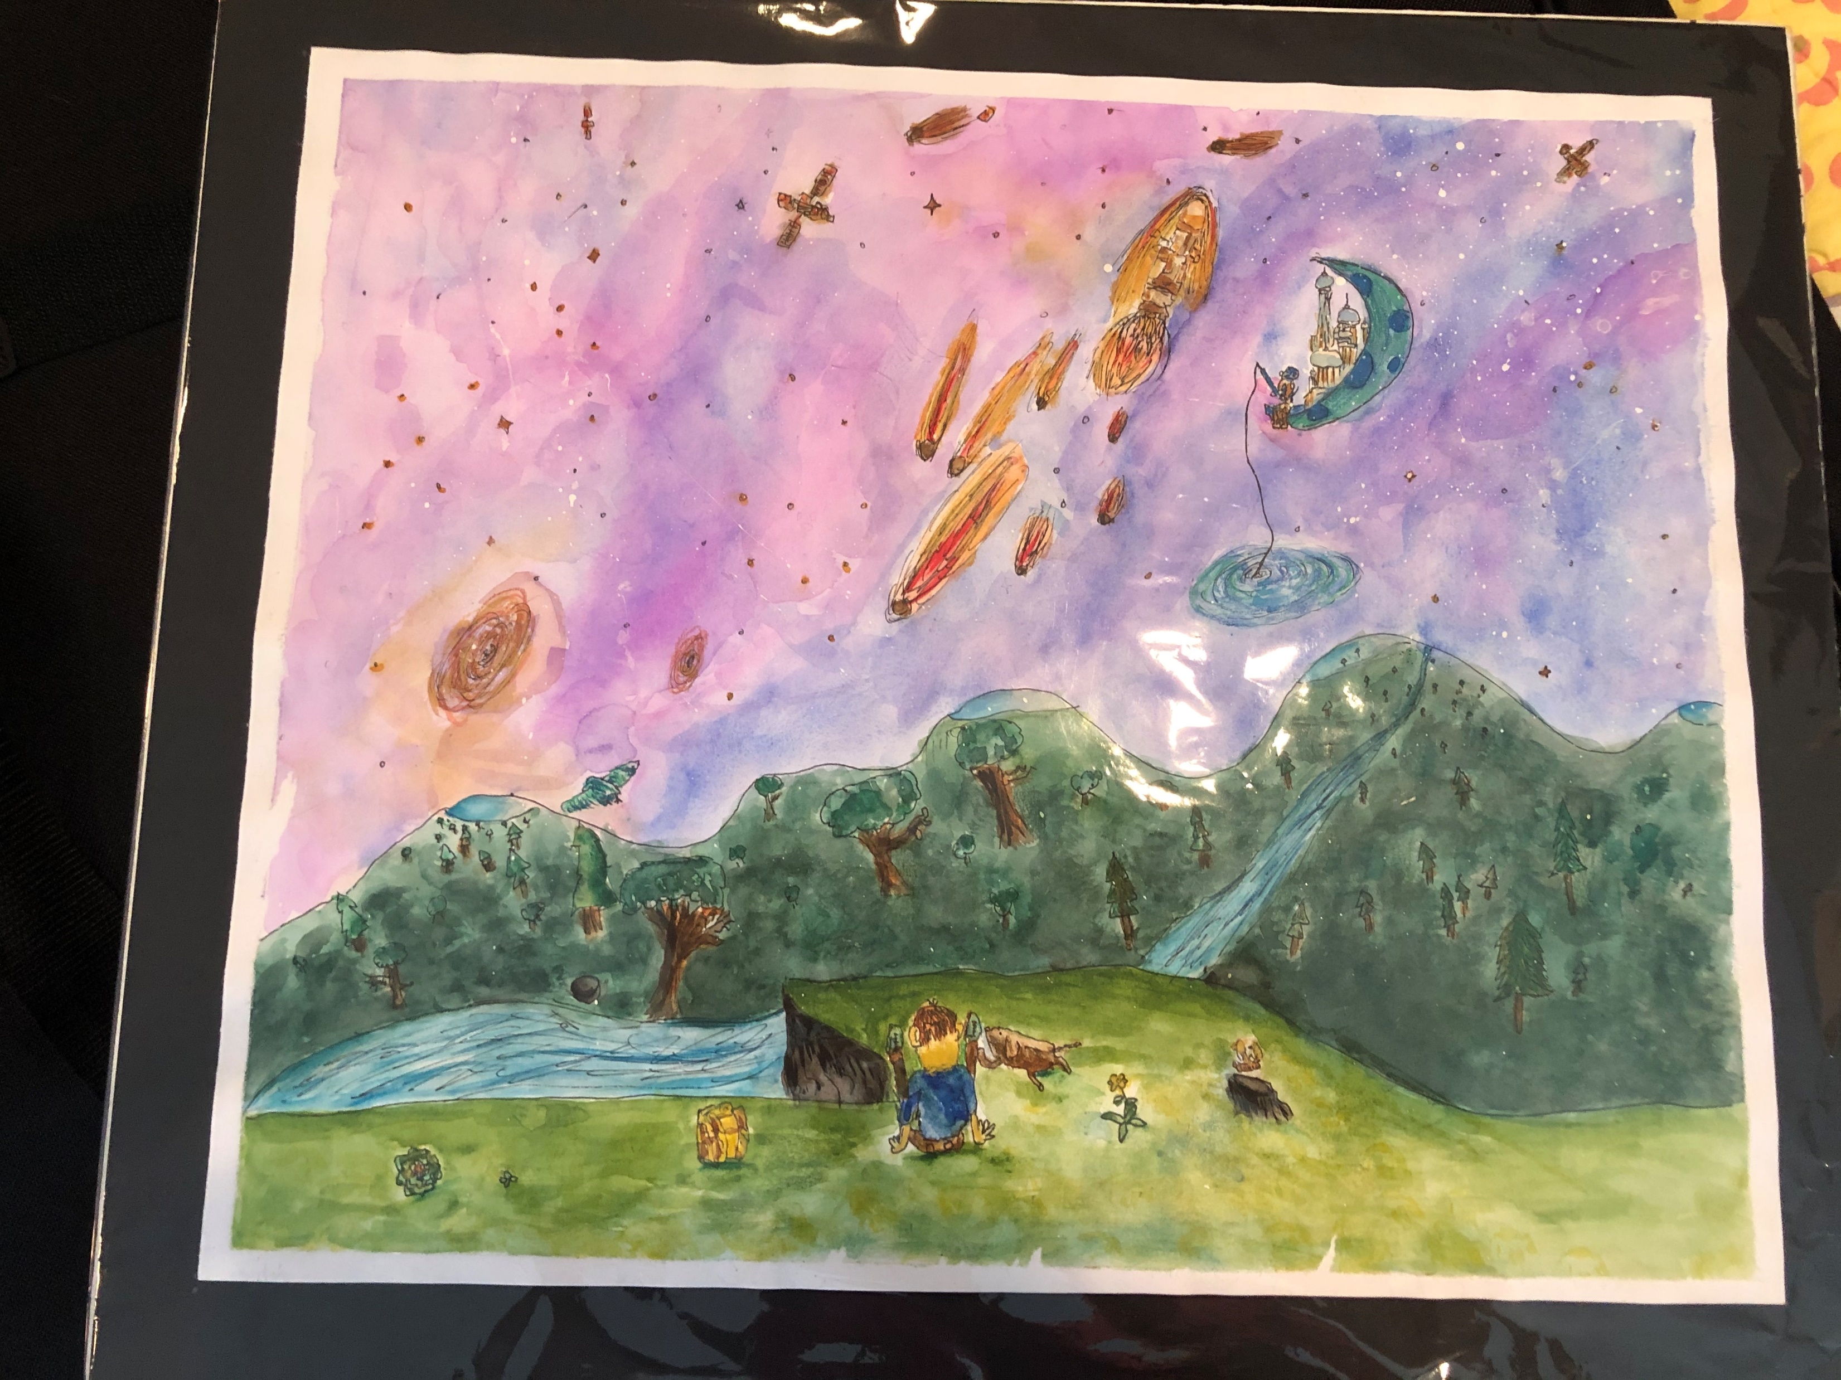
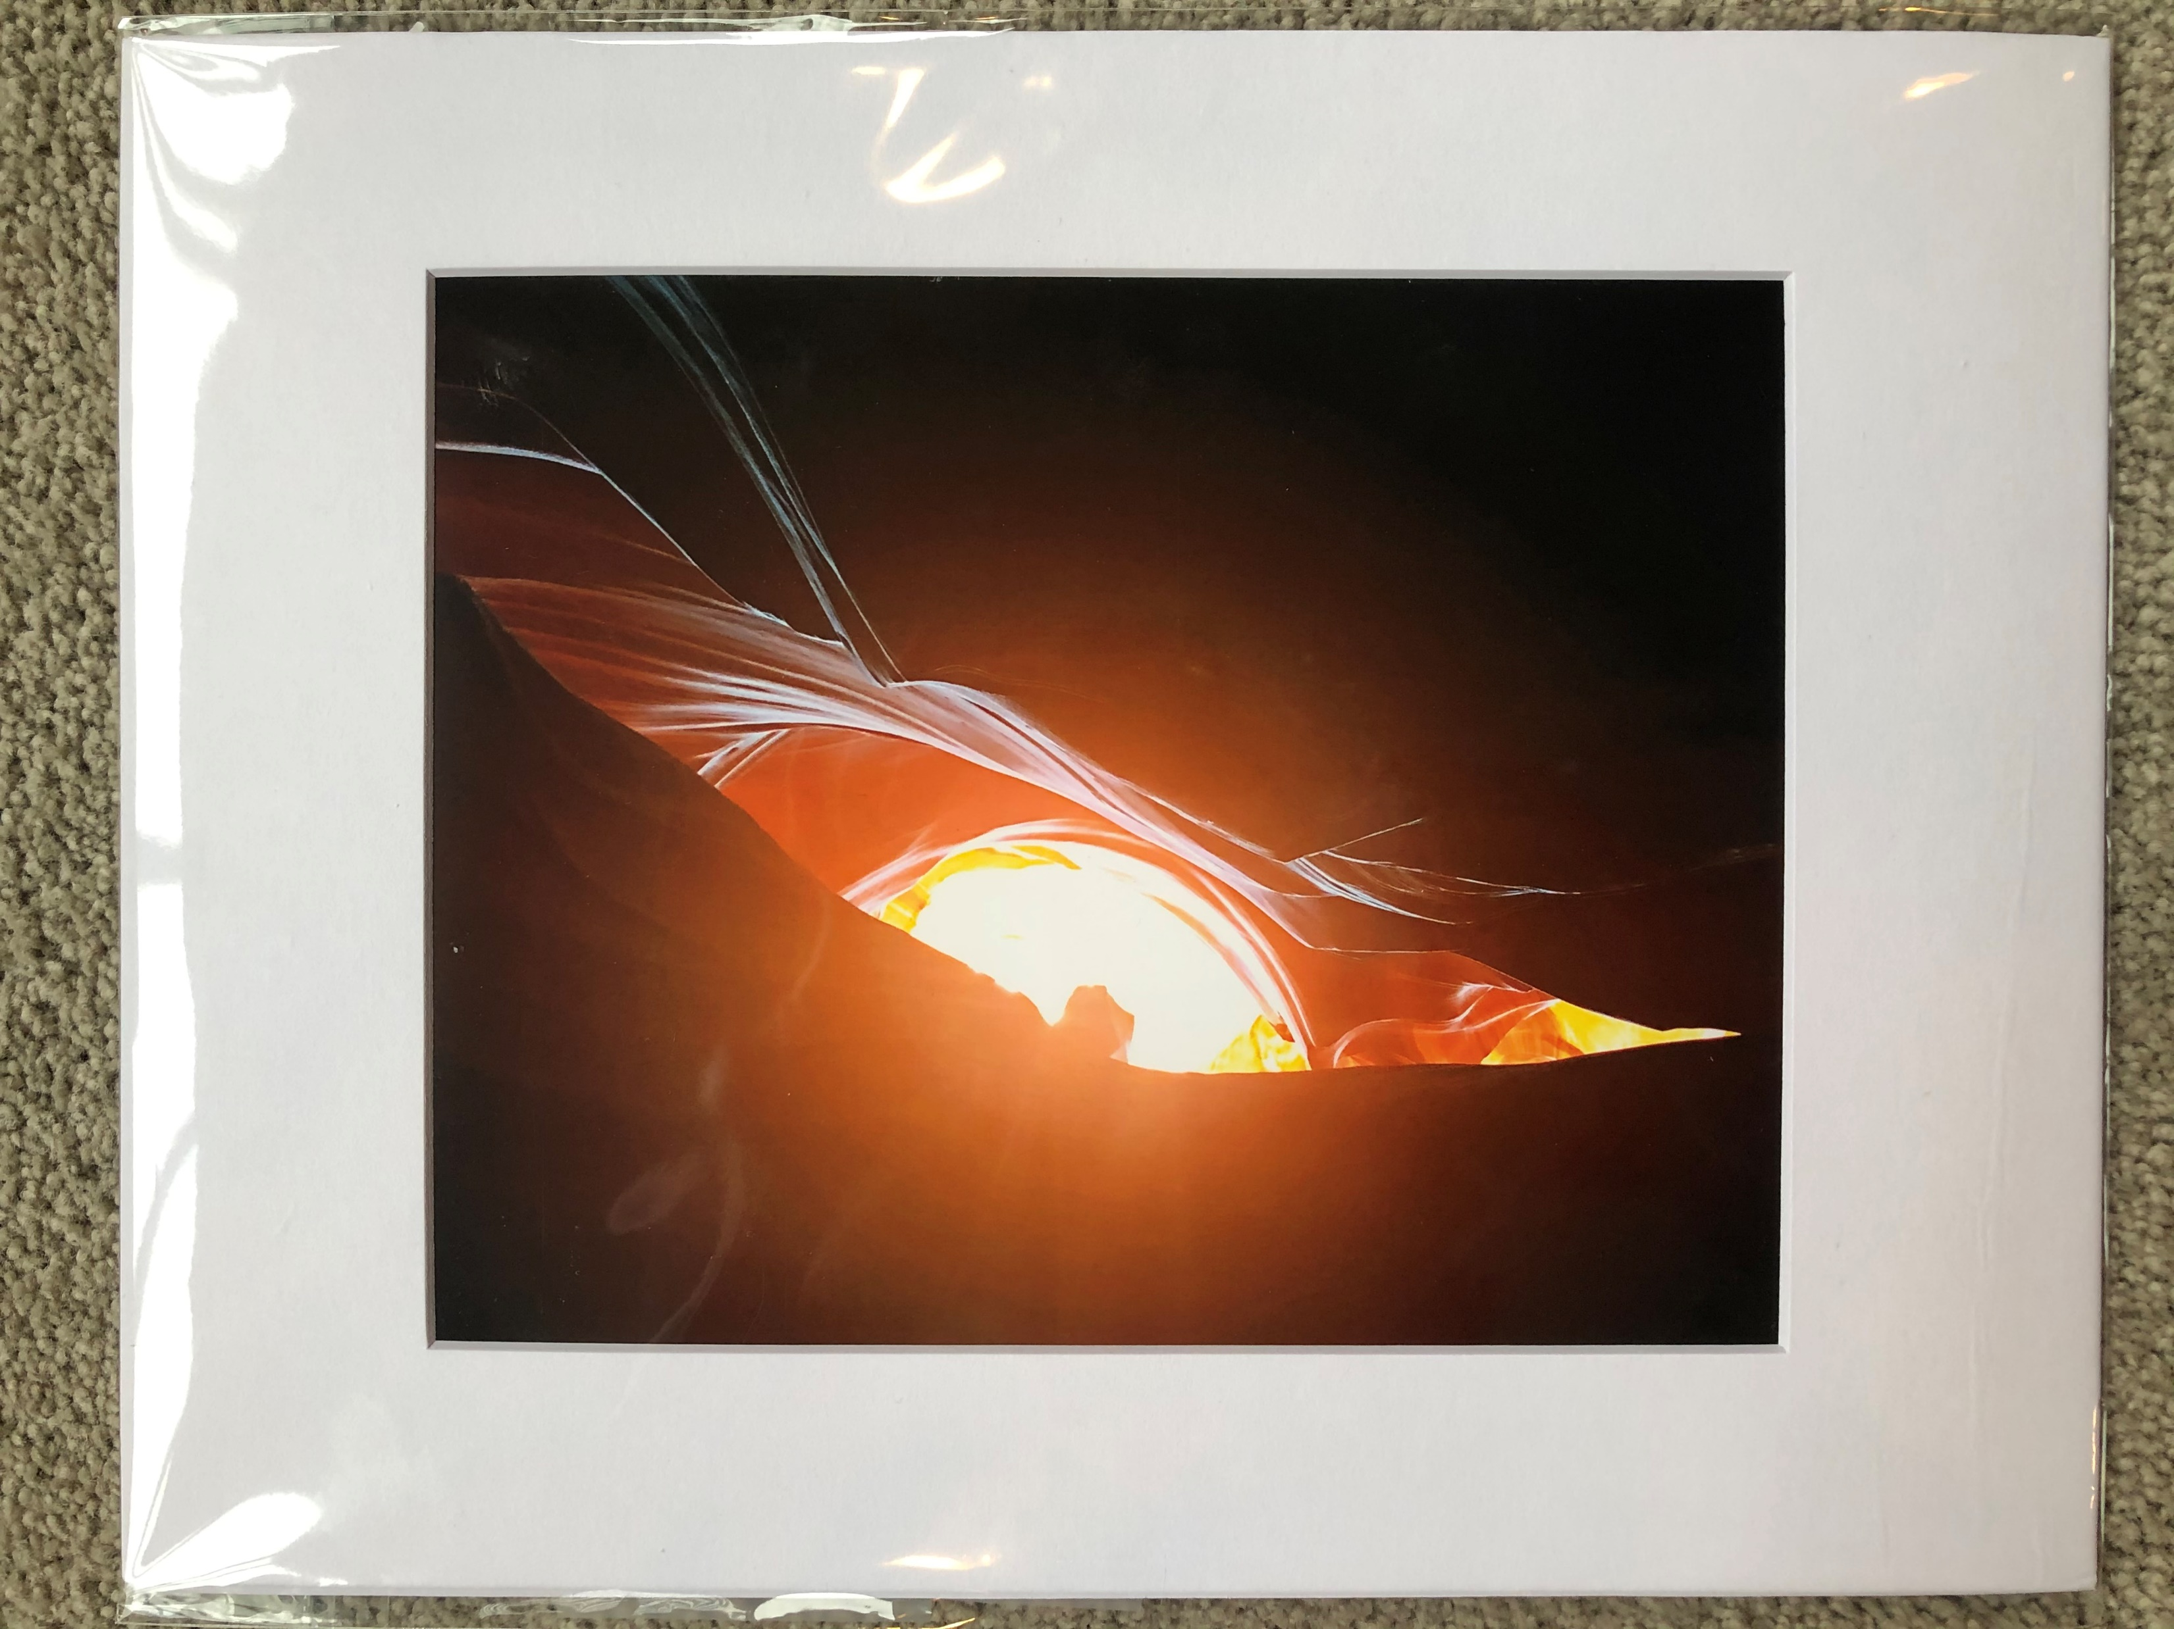
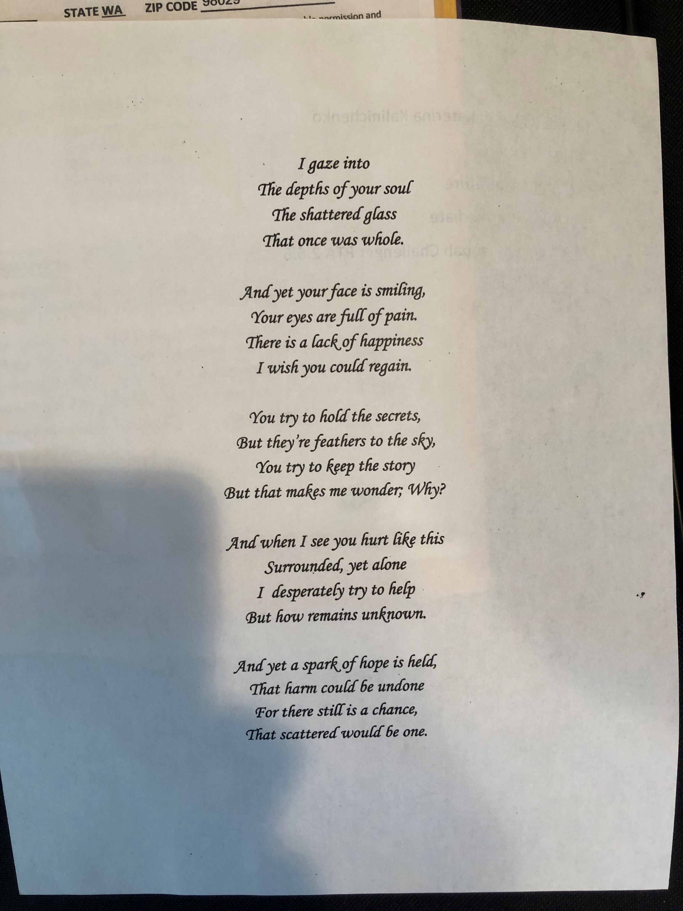
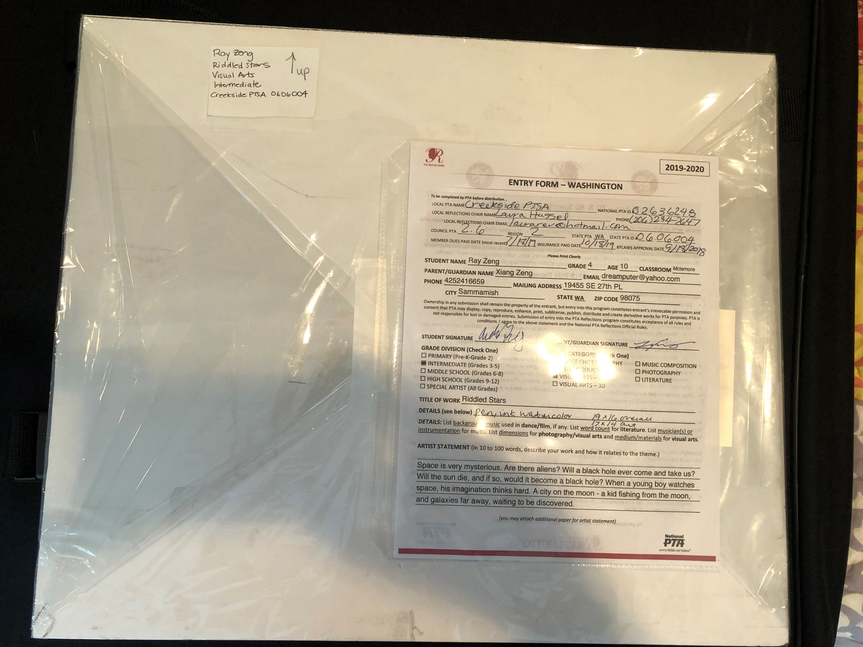
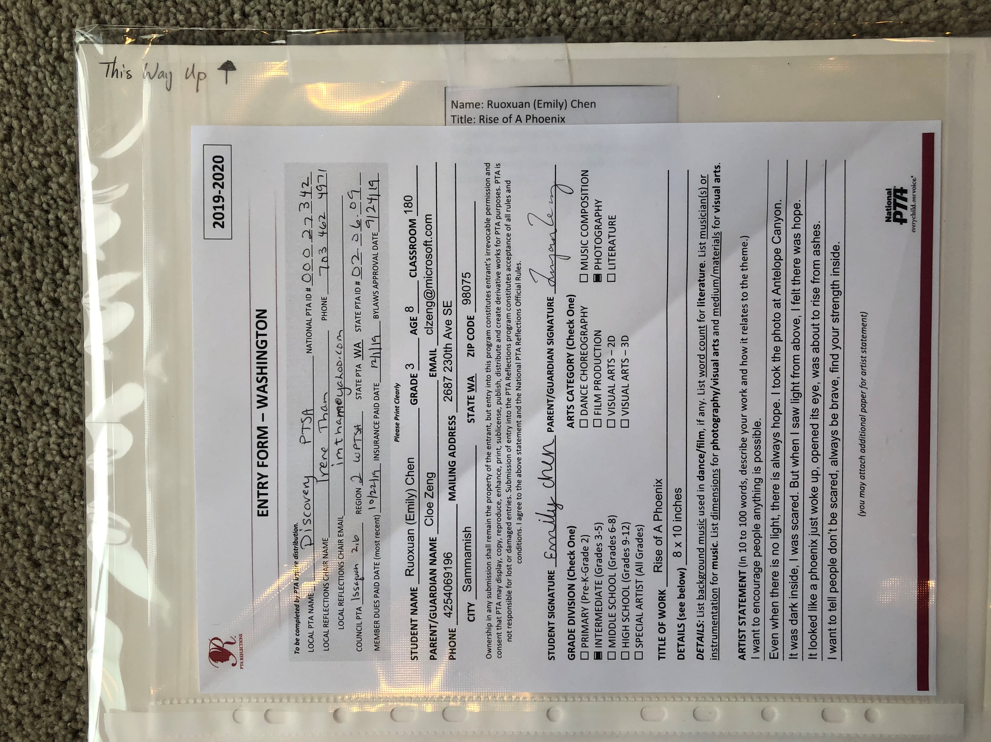
LITERATURE
District Turn-in
Literature:
Resealable manila envelope
Multiple copies, each labeled on back
Entry form on back in plastic sleeve
Examples of correct labeling and wrapping.
VISUAL ARTS
Visual Arts:
Rigid mounting
Cellophane wrap
Entry form on back
Piece labeled (with orientation) on back
front
front
Others:
Resealable manila envelope
Entry form on back in plastic sleeve
USB drive labeled
ALL OTHERS
back
back

Slide 37
Remote Learning - Celebrating COVID-19
Here are some suggestions for celebrating your artists remotely:
ZOOM style party
E-news announcements
Special fun digital message emailed to artists’ families
Slide show of art on school site
And/or, consider waiting until Spring to celebrate in hopes the buildings will be operational.
Share your celebration methods with us and each other to inspire ideas across the district.

Slide 38
Celebrating your Participants
Suggestions for acclaim and celebration:
Announce awardees to school community via all modes of communication
Provide ribbons, certificates, prizes, etc. to every entrant
Host an art walk, student reception, on-going wall display, photos on website, incorporation with other school event, etc.
Note, pieces advancing to district cannot be returned to you until after the January District Reception (or later if they move onto the state level). Please do not plan to use the artwork for a celebration after the November district turn-in date (even if you have been allowed to do this in the past). If your recognition needs to be after the district due date, take photos of the art to use during your celebration.

Slide 39
Wrapping Up and Reporting Success
Final steps:
Report student participation and document finalists in school Reflections chair documents.
Send results to your PTA president or Standard of Excellence administrator for their annual spring report.
Return non-advancing submissions to students.
Recognize volunteers, supporting staff, and businesses.
Congratulate yourself on a job well done!

Slide 40
Contacts and Resources

Slide 41
Reflections Resources
Websites
District: www.issaquahptsa.org/reflections-programs
State: www.wastatepta.org/events-programs/reflections/
National: www.pta.org/home/programs/reflections
Contacts
District Co-chairs: reflections@issaquahptsa.org
Leah Gibson, Kristen Allen-Bentsen, Heather Bratton
Other
WSPTSA Reflections page: www.facebook.com/groups/737015379822191/
Ribbons: www.ribbonsgalore.com
www.shoppta.com/pta-reflections/

Slide 42
Thank you!

