Slide 1
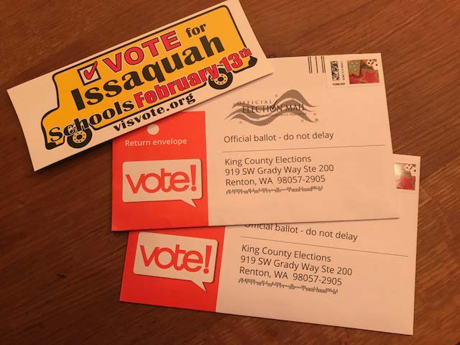
FINAL WEEK – IT’S CRUNCH TIME! REMIND YOUR FRIENDS, NEIGHBORS AND SCHOOL COMMUNITY TO VOTE YES AND RETURN THEIR BALLOTS! Ballots due NEXT Tuesday, February 13th! Last Honk & Waves: Monday, February 12th 7-8:30am & 5-6:30pm Sign Up Genius Link: http://www.signupgenius.com/go/60b0f4da9a829aaf49-2018 Contact Korista Smith-Barney with questions at dkbarney@live.com MAKE SURE TO DROP OFF SIGNS AT YOUR HONK & WAVE LOCATIONS Middle & high school students can earn community service hours! Post a photo from your honk and wave on your PTA Facebook page!!!
THANK YOU ALL FOR MAILING YOUR PTA POSTCARDS OUT!
You’re Invited. . .
Levy 2018 Campaign Gathering
Tuesday, Feb. 13th
7:00-9:00pm
Initial ballot results posted at 8:15
Weaver Residence
3749 234th Avenue SE
Sammamish, WA 98075
All donors, volunteers and supporters of VIS are welcome to join us and celebrate our combined campaign efforts! Open house with light appetizers, beverages, and time to socialize!

Slide 2
EVERY VOTE COUNTS!
THIS IMAGE WILL BE POSTED ON THE VIS FACEBOOK PAGE THIS SATURDAY. PLEASE SHARE SHARE SHARE THIS IMAGE TO YOUR
PTSA FB PAGE AND PERSONAL FB PAGES!

